Slide 1
MAESTRO Workshop #2
The Incidental Catch Model
Using Life History & Fishery Removals to (re)construct population dynamic trends
Sub project 4.2
David Keith, Heather Bowlby, Freya Keyser and
Julie Charbonneau

Slide 2
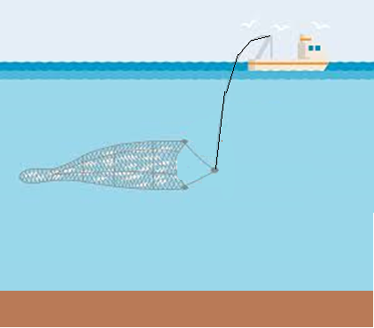


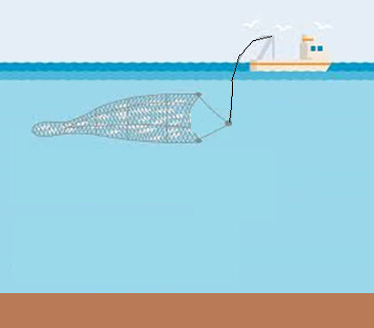



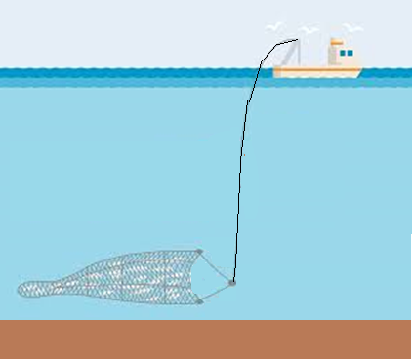
Task 4 Objectives
Explore the impact of varying catch strategies on the diversity of stocks within an ecosystem
How does redistributing catch across species impact function diversity
Are their optimal harvesting strategies that can optimize functional diversity

Slide 3
Task 4 Objectives
Explore the impact of varying catch strategies on the diversity of stocks within an ecosystem
How does redistributing catch across species impact function diversity
Are their optimal harvesting strategies that can optimize functional diversity
How might climate impacts influence these strategies

Slide 4
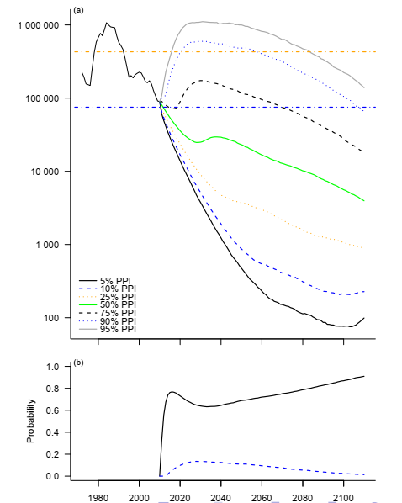
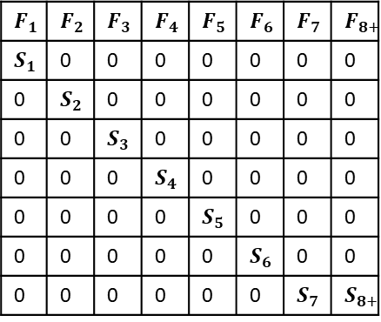
The Incidental Catch Model
To do this we need a model to project into the future
For both data limited and data rich stocks
For data rich stocks it would be nice to use the past to inform the future
For data poor stocks we could use life history information
Widely available life history information can be used to estimate
Longevity
Fecundity
Natural Mortality
This + linear algebra is all we need to estimate population growth rates
Leslie matrix
The Incidental Catch Model (ICM)
Enables us to use data from data rich stocks to parameterize model
Enables us to use life history information for data poor stocks to parameterize model
$$F_{1}$$ | $$F_{2}$$ | $$F_{3}$$ | $$F_{4}$$ | $$F_{5}$$ | $$F_{6}$$ | $$F_{7}$$ | $$F_{8+}$$
$$S_{1}$$ | 0 | 0 | 0 | 0 | 0 | 0 | 0
0 | $$S_{2}$$ | 0 | 0 | 0 | 0 | 0 | 0
0 | 0 | $$S_{3}$$ | 0 | 0 | 0 | 0 | 0
0 | 0 | 0 | $$S_{4}$$ | 0 | 0 | 0 | 0
0 | 0 | 0 | 0 | $$S_{5}$$ | 0 | 0 | 0
0 | 0 | 0 | 0 | 0 | $$S_{6}$$ | 0 | 0
0 | 0 | 0 | 0 | 0 | 0 | $$S_{7}$$ | $$S_{8+}$$

Slide 5
What is the ICM model
Developed for sharks
Used life history information and catch history to reconstruct population dynamics
Life history data included
Size
Longevity
Offspring production
A time series of removals by fisheries (all sources of removals)
An estimate of population size at one point in time
Talk to Heather for more details on how it’s being used for Sharks

Slide 6
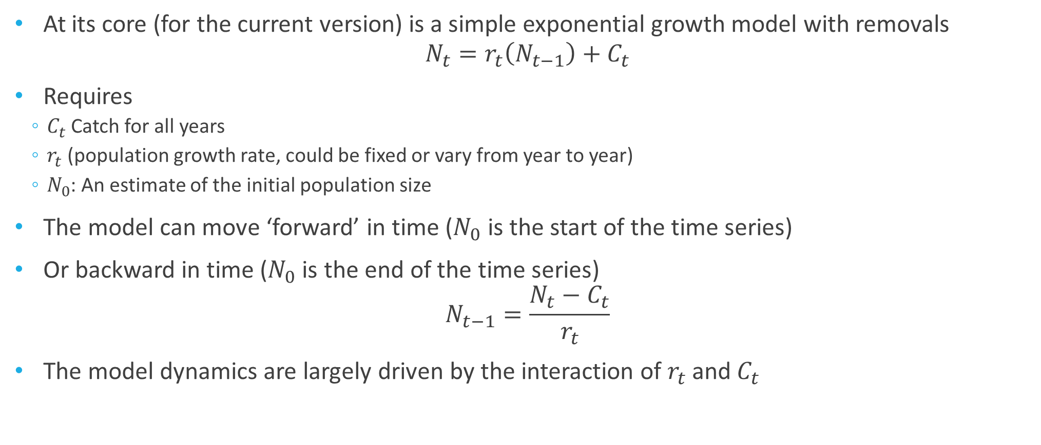
Under the Hood
At its core (for the current version) is a simple exponential growth model with removals
$$N_{t}=r_{t}\left(N_{t−1}\right)+C_{t}$$
Requires
$C_{t}$Catch for all years
$r_{t}$ (population growth rate, could be fixed or vary from year to year)
$N_{0}$: An estimate of the initial population size
The model can move ‘forward’ in time ($N_{0}$ is the start of the time series)
Or backward in time ($N_{0}$ is the end of the time series)
$$N_{t−1}=\frac{N_{t}−C_{t}}{r_{t}}$$
The model dynamics are largely driven by the interaction of $r_{t}$ and $C_{t}$

Slide 7
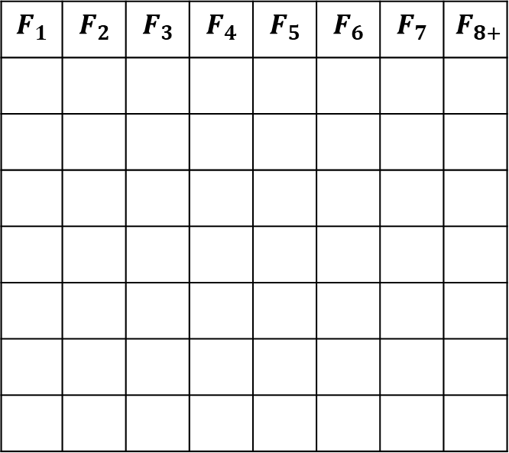
Decomposing $r_{t}$ ($N_{t}=r_{t}\left(N_{t−1}\right)+C_{t}$)
The rate of growth determines how quickly a population grows (or declines)
Driven by fecundity
$$F_{1}$$ | $$F_{2}$$ | $$F_{3}$$ | $$F_{4}$$ | $$F_{5}$$ | $$F_{6}$$ | $$F_{7}$$ | $$F_{8+}$$

Slide 8
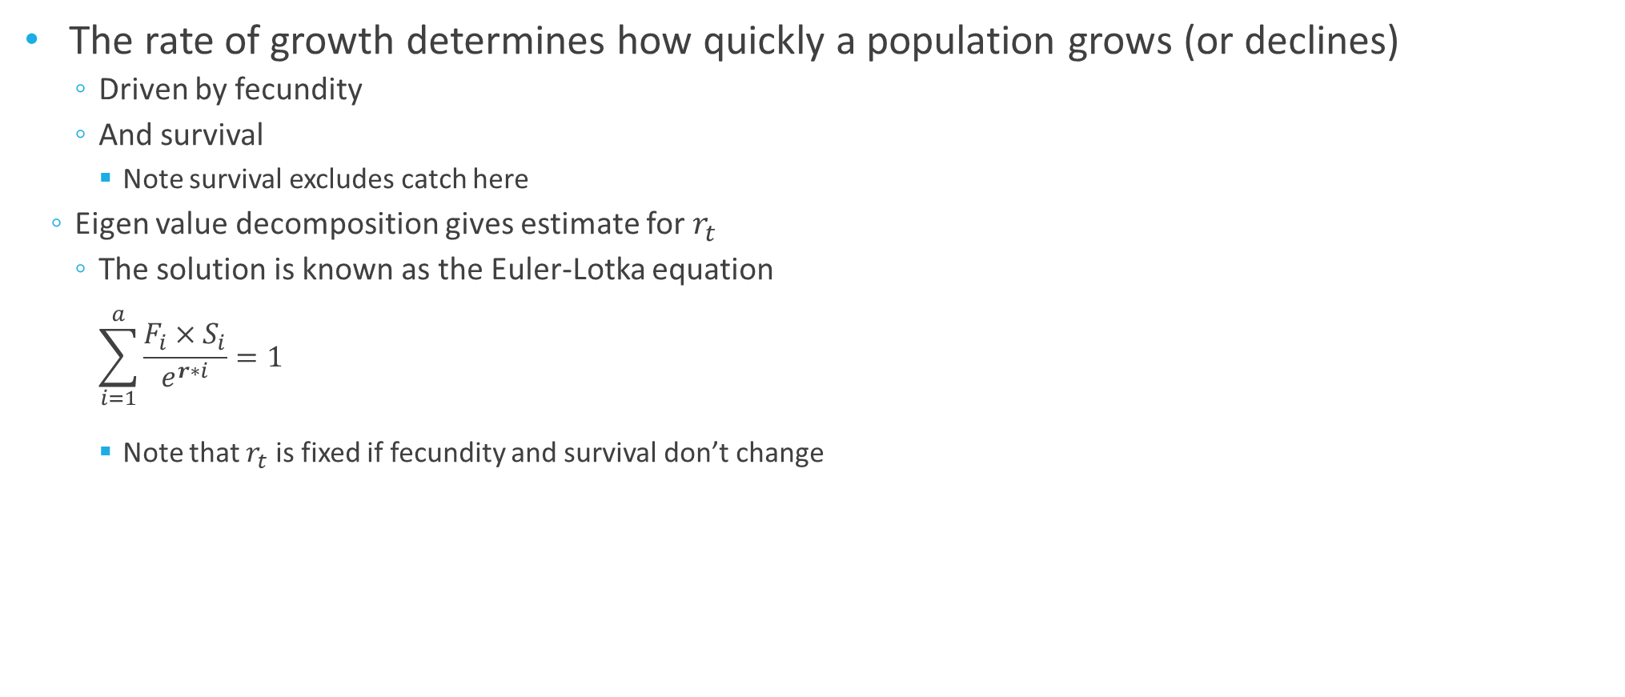
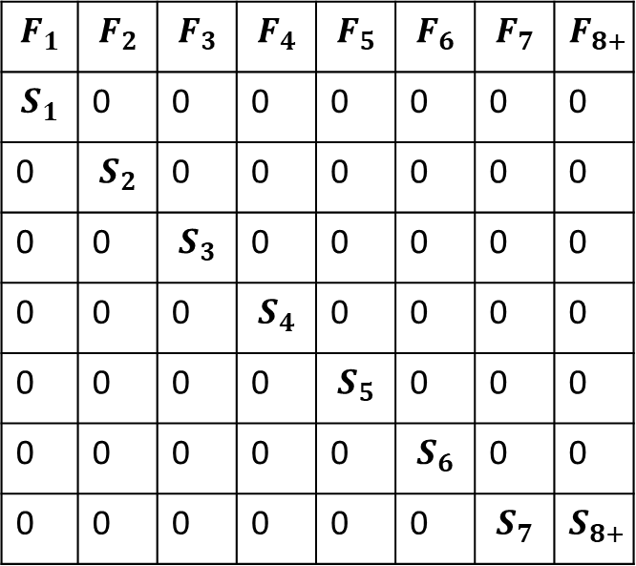
Decomposing $r_{t}$ ($N_{t}=r_{t}\left(N_{t−1}\right)+C_{t}$)
The rate of growth determines how quickly a population grows (or declines)
Driven by fecundity
And survival
Note survival excludes catch here
Eigen value decomposition gives estimate for $r_{t}$
The solution is known as the Euler-Lotka equation
$$\sum_{i=1}^{a}{\frac{F_{i}×S_{i}}{e^{r∗i}}=1}$$
Note that $r_{t}$ is fixed if fecundity and survival don’t change
$$F_{1}$$ | $$F_{2}$$ | $$F_{3}$$ | $$F_{4}$$ | $$F_{5}$$ | $$F_{6}$$ | $$F_{7}$$ | $$F_{8+}$$
$$S_{1}$$ | 0 | 0 | 0 | 0 | 0 | 0 | 0
0 | $$S_{2}$$ | 0 | 0 | 0 | 0 | 0 | 0
0 | 0 | $$S_{3}$$ | 0 | 0 | 0 | 0 | 0
0 | 0 | 0 | $$S_{4}$$ | 0 | 0 | 0 | 0
0 | 0 | 0 | 0 | $$S_{5}$$ | 0 | 0 | 0
0 | 0 | 0 | 0 | 0 | $$S_{6}$$ | 0 | 0
0 | 0 | 0 | 0 | 0 | 0 | $$S_{7}$$ | $$S_{8+}$$

Slide 9
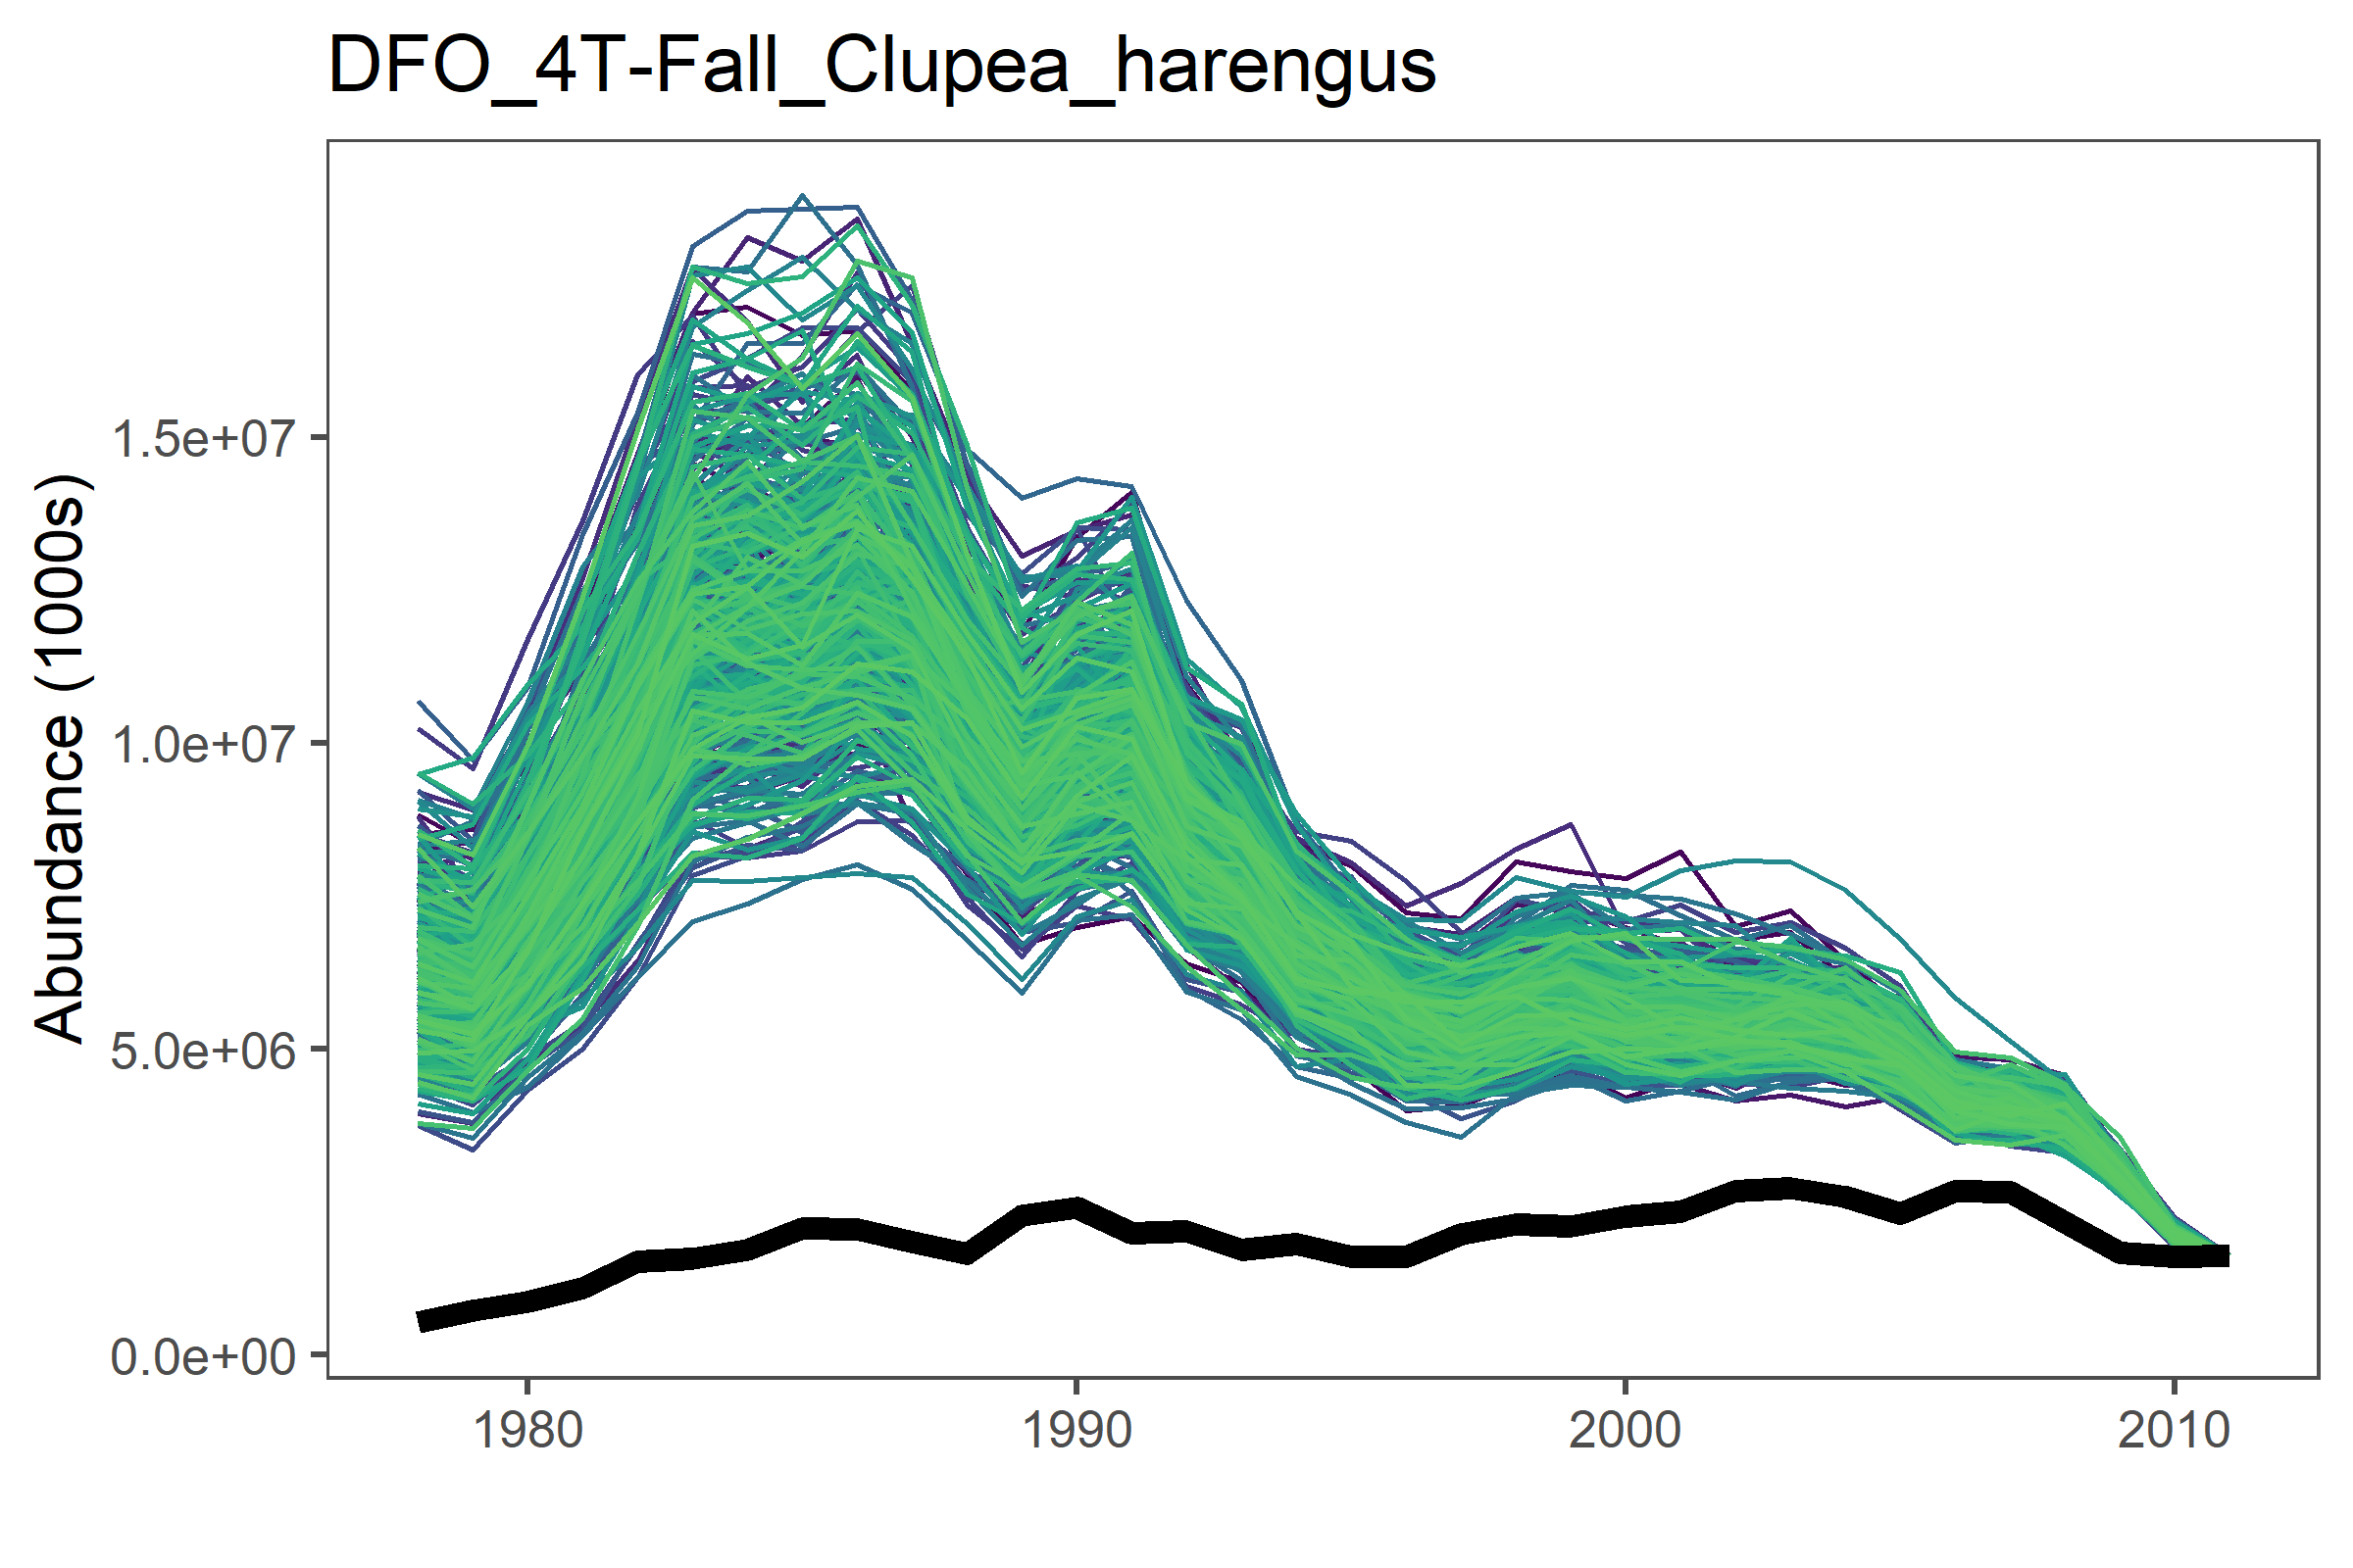
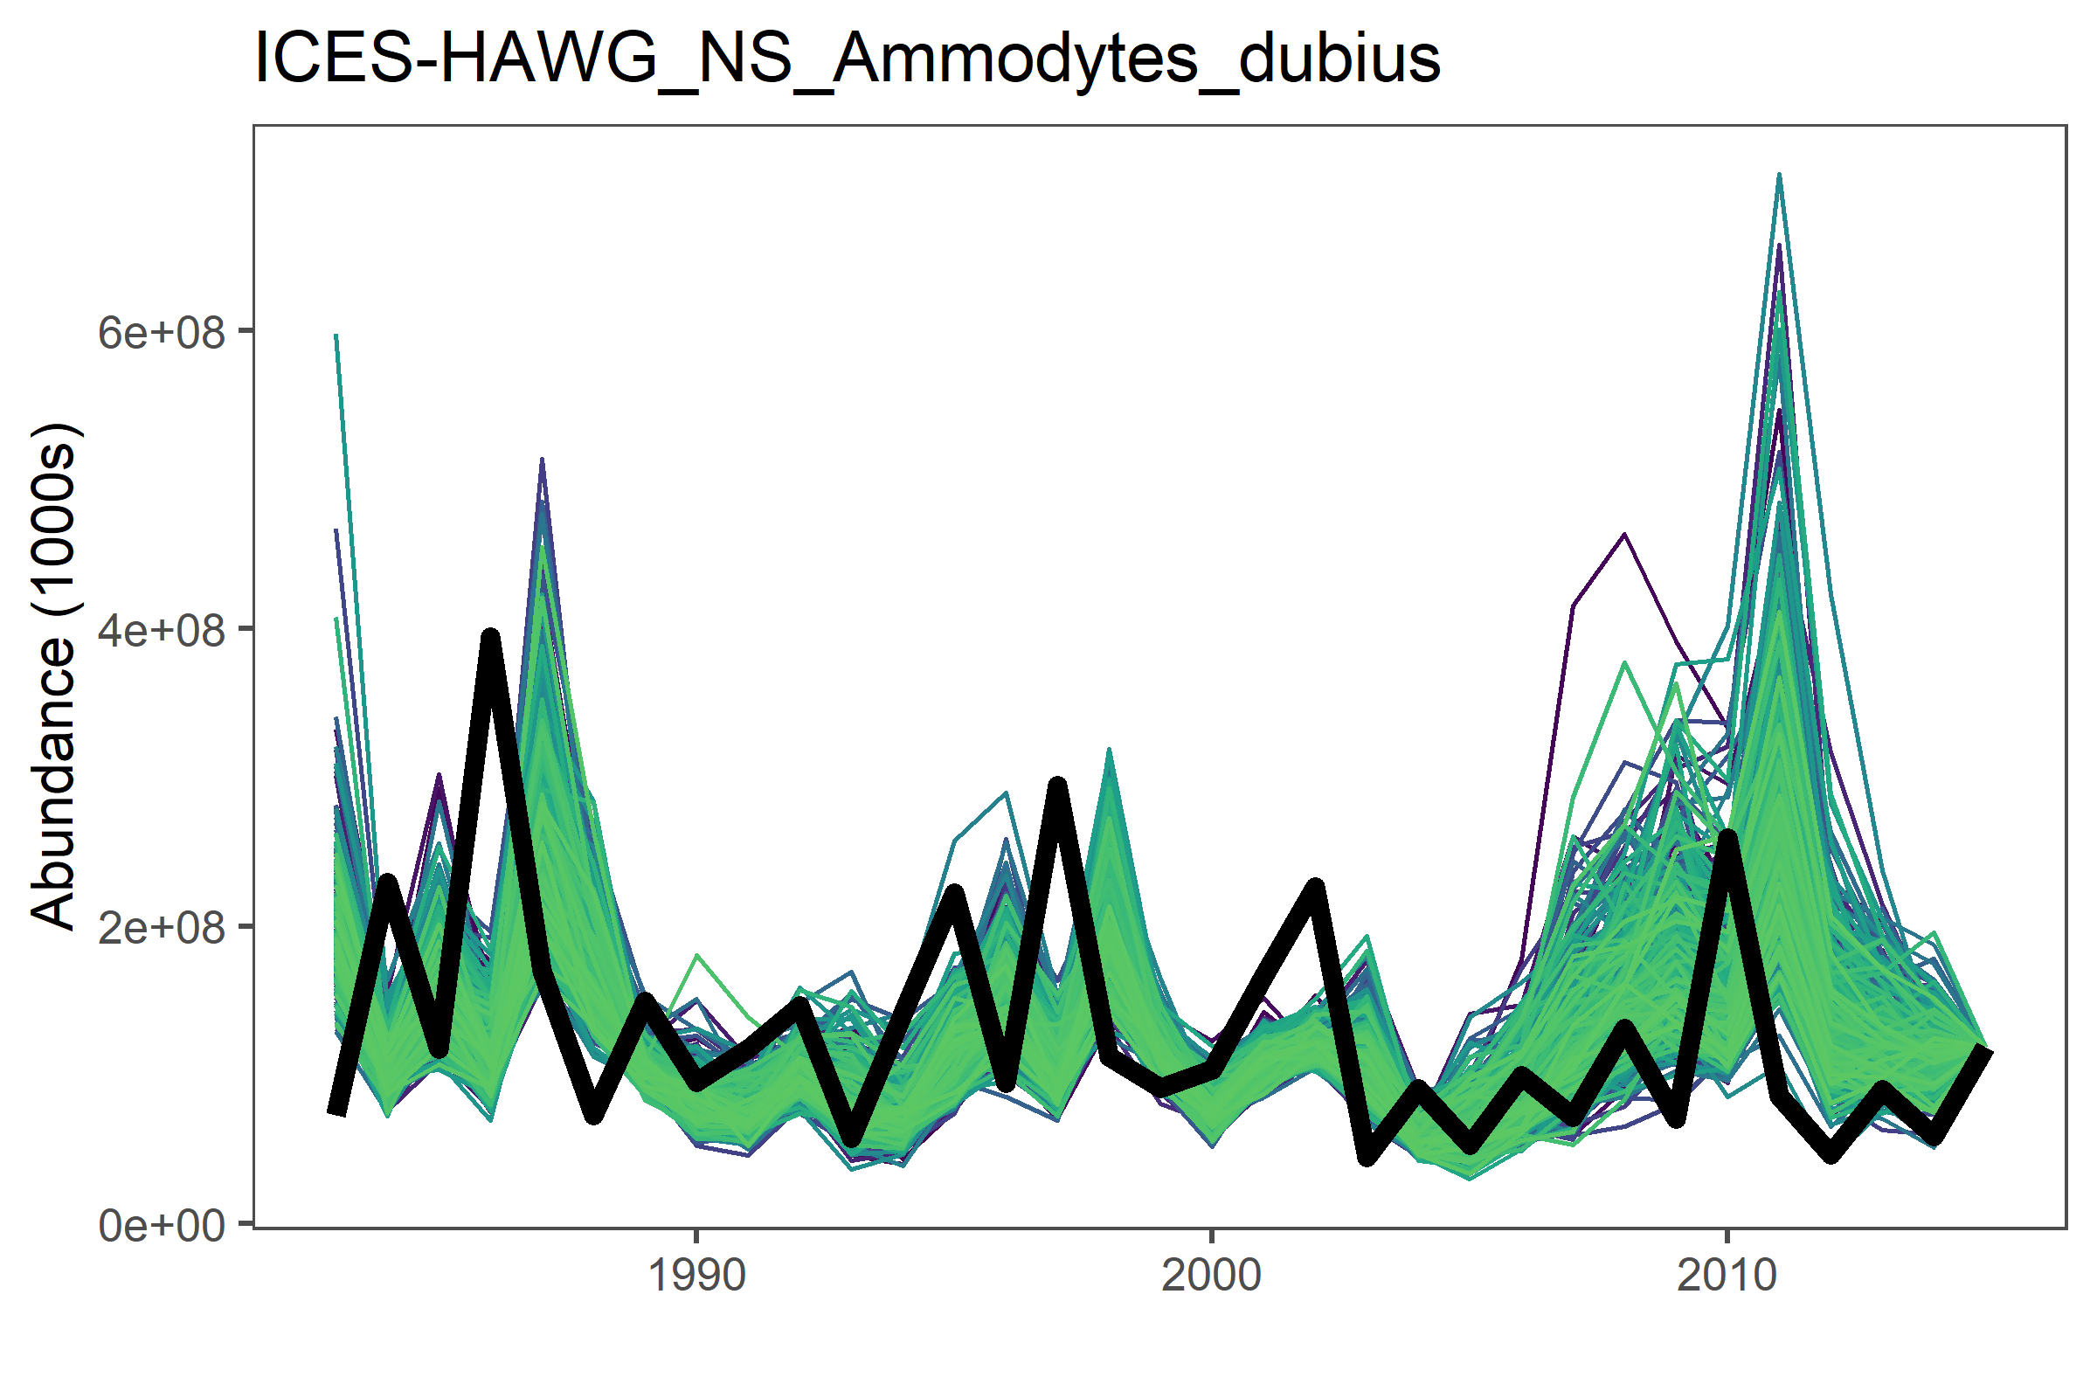
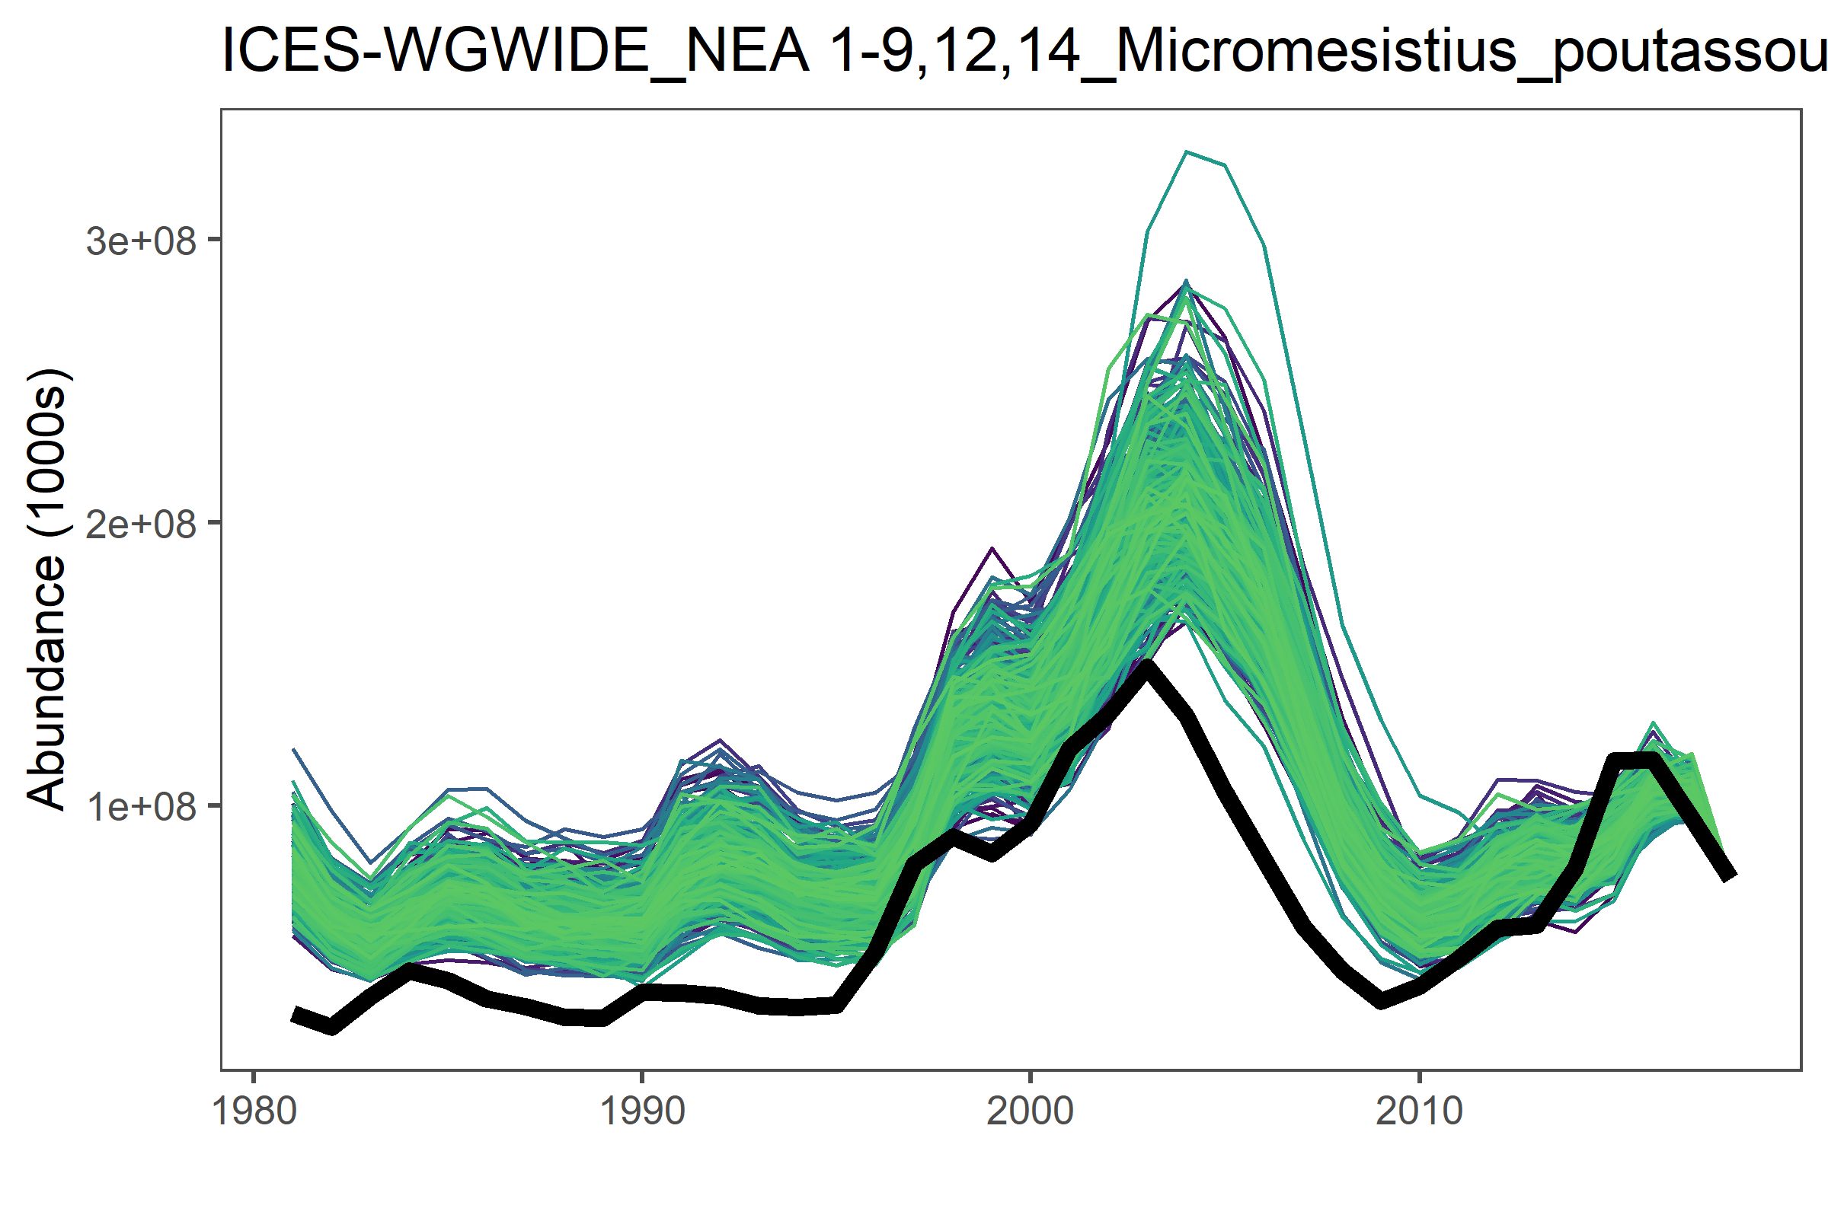
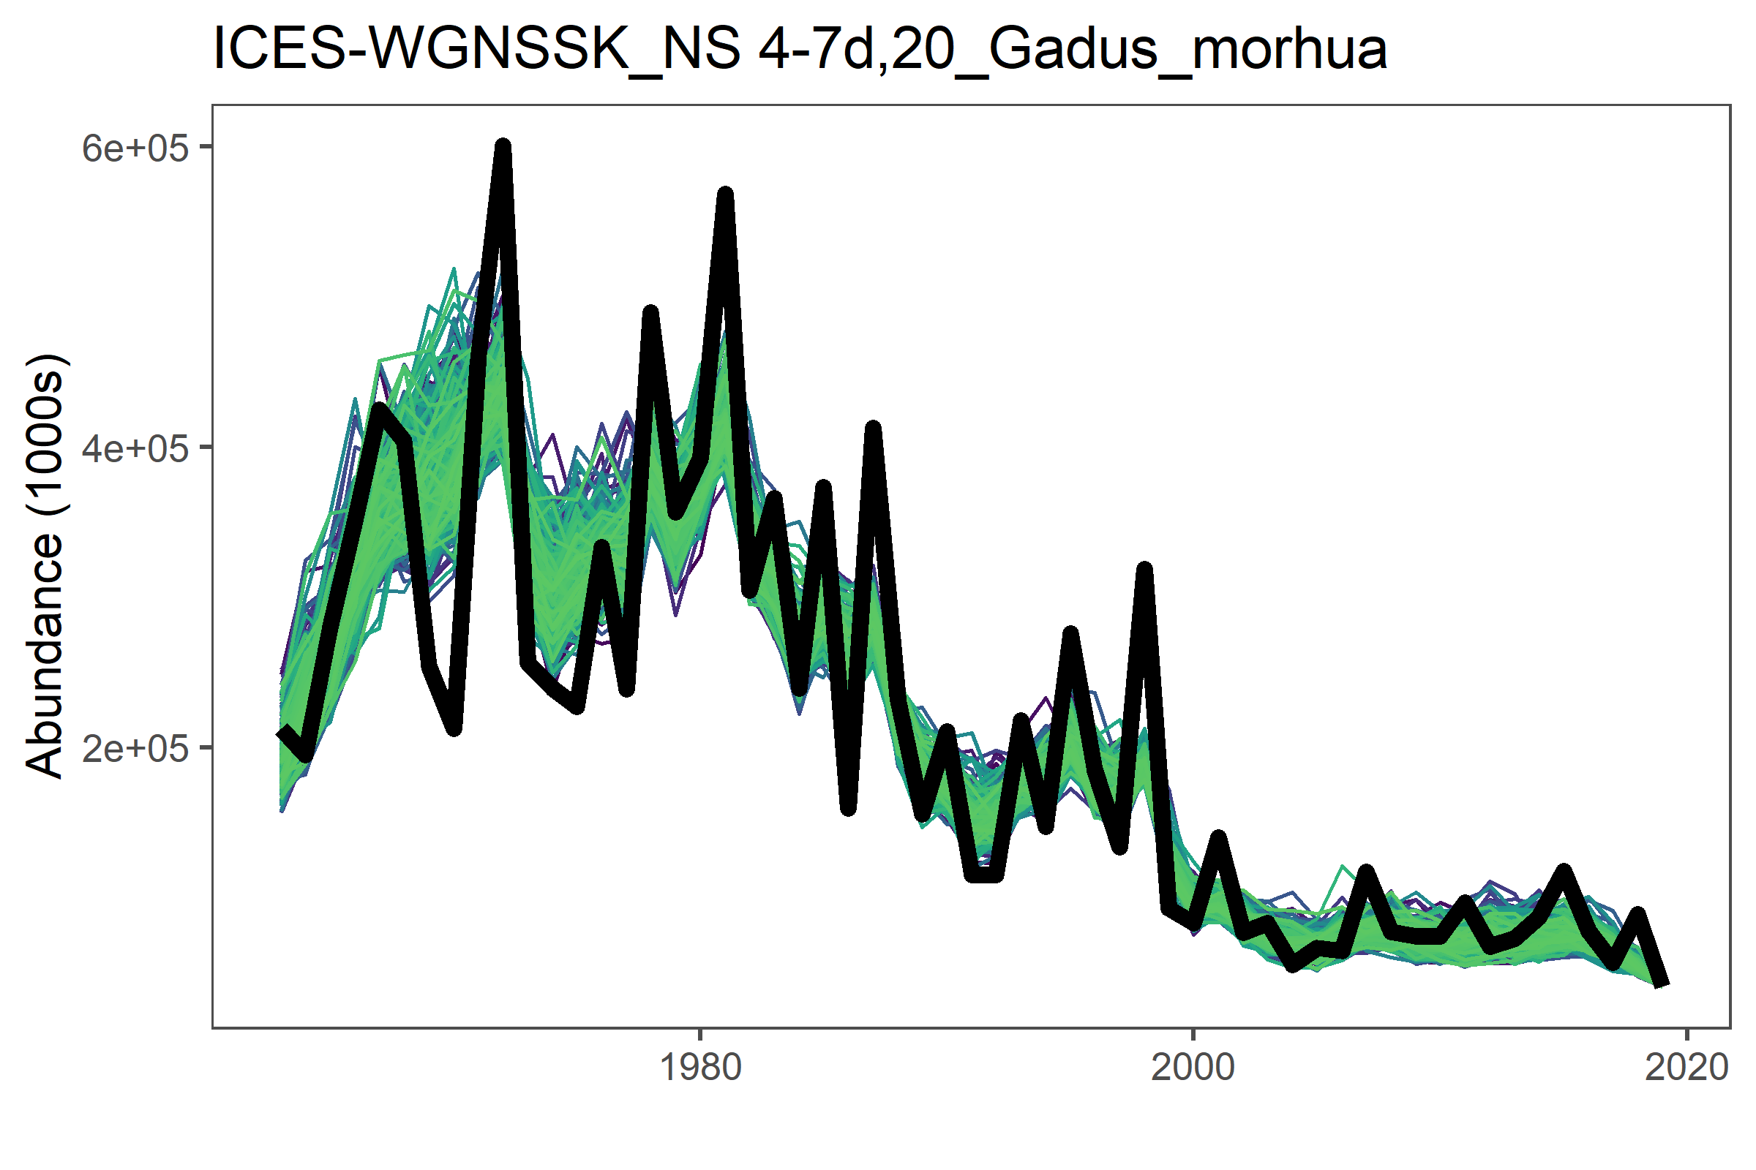
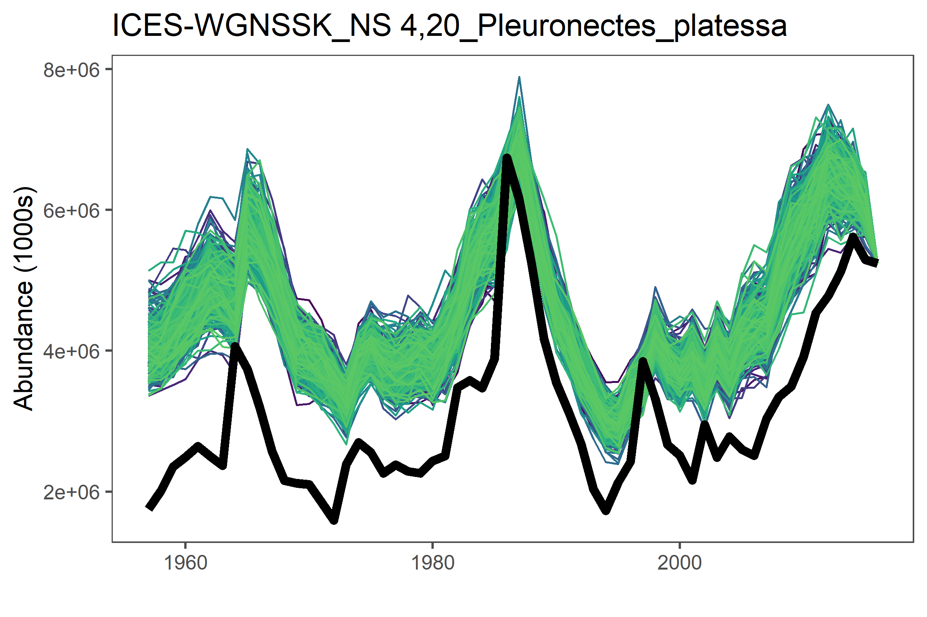
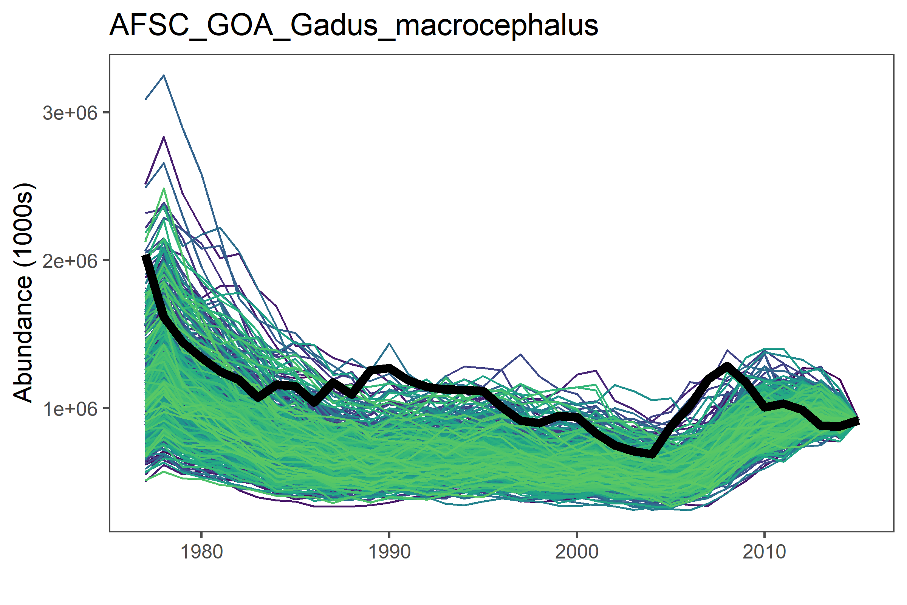
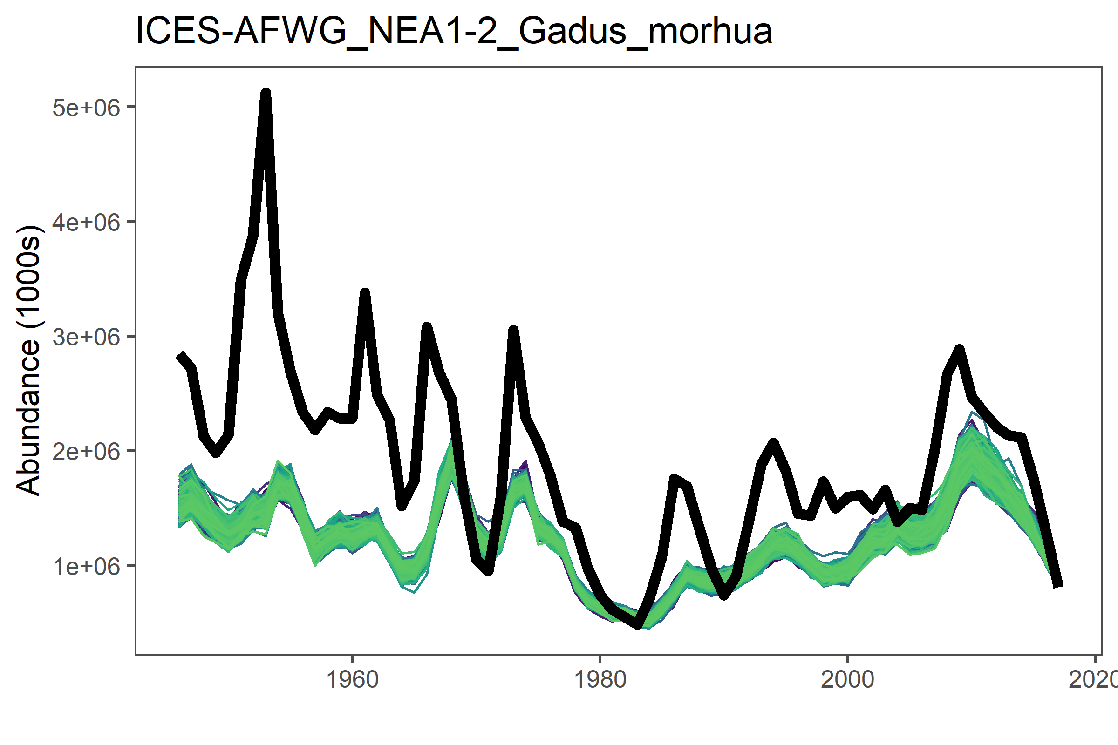
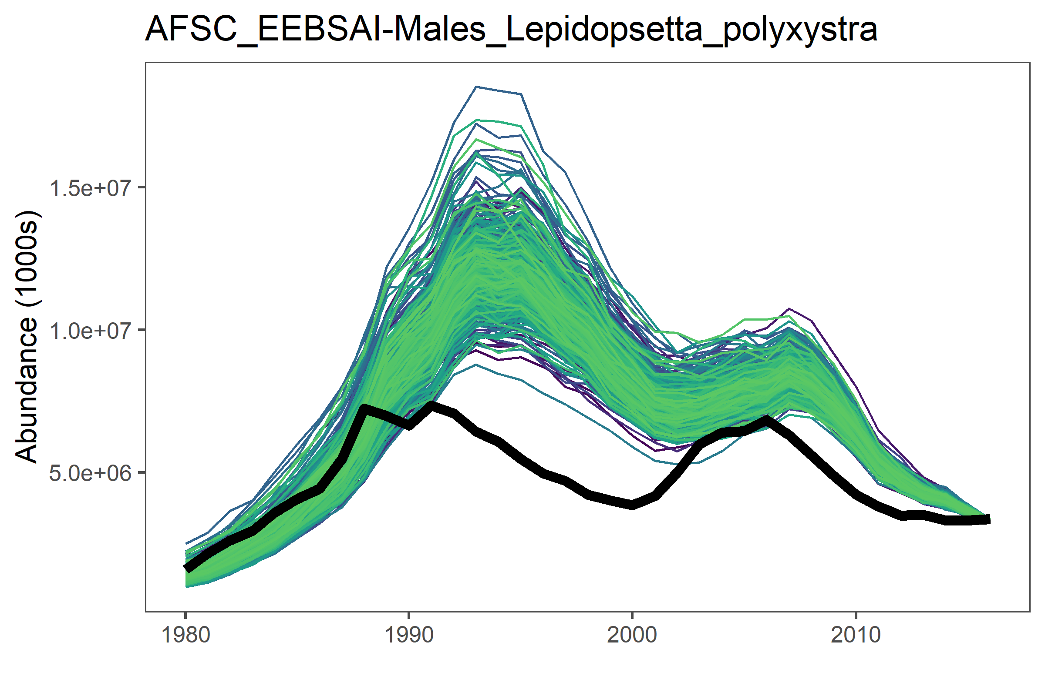
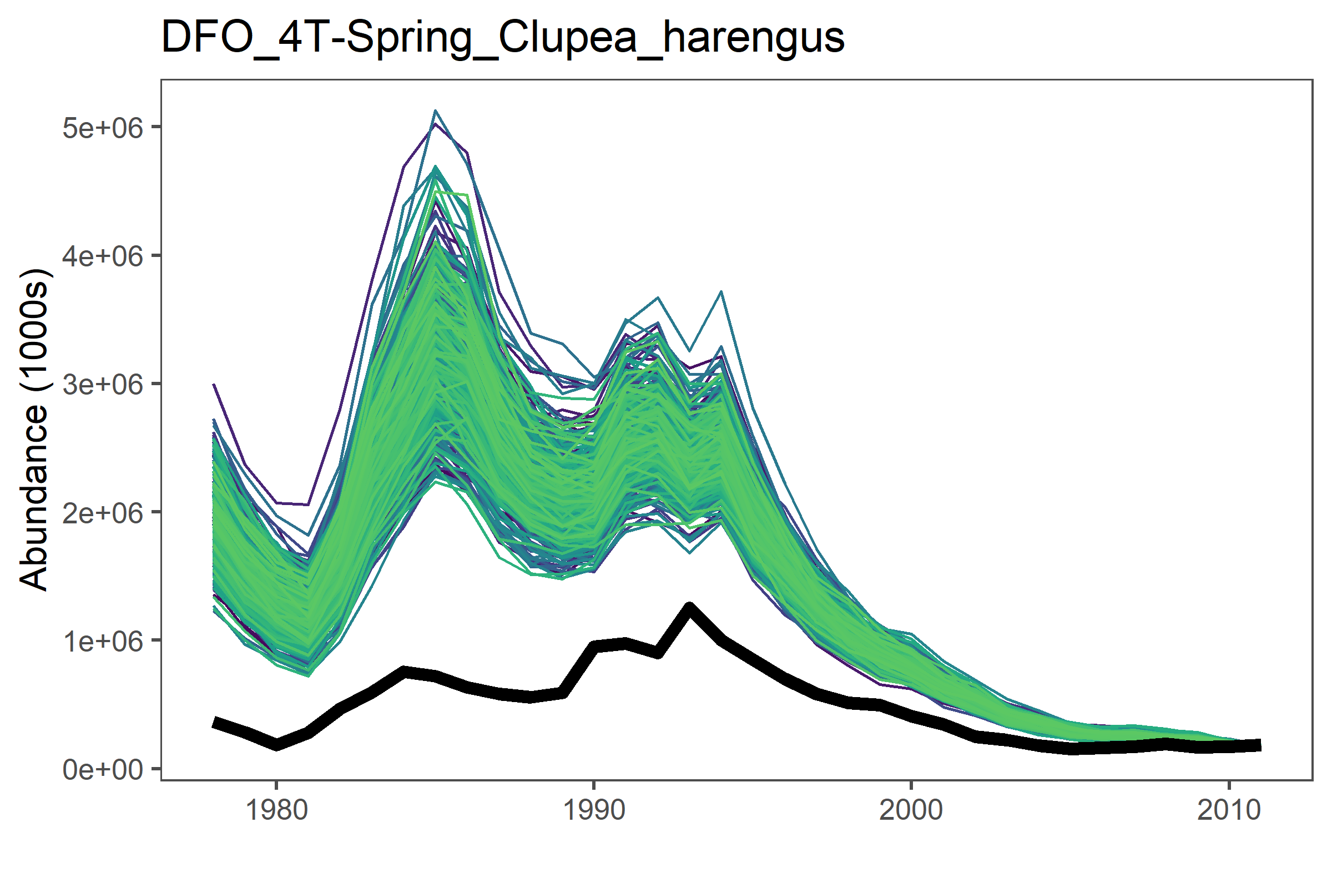
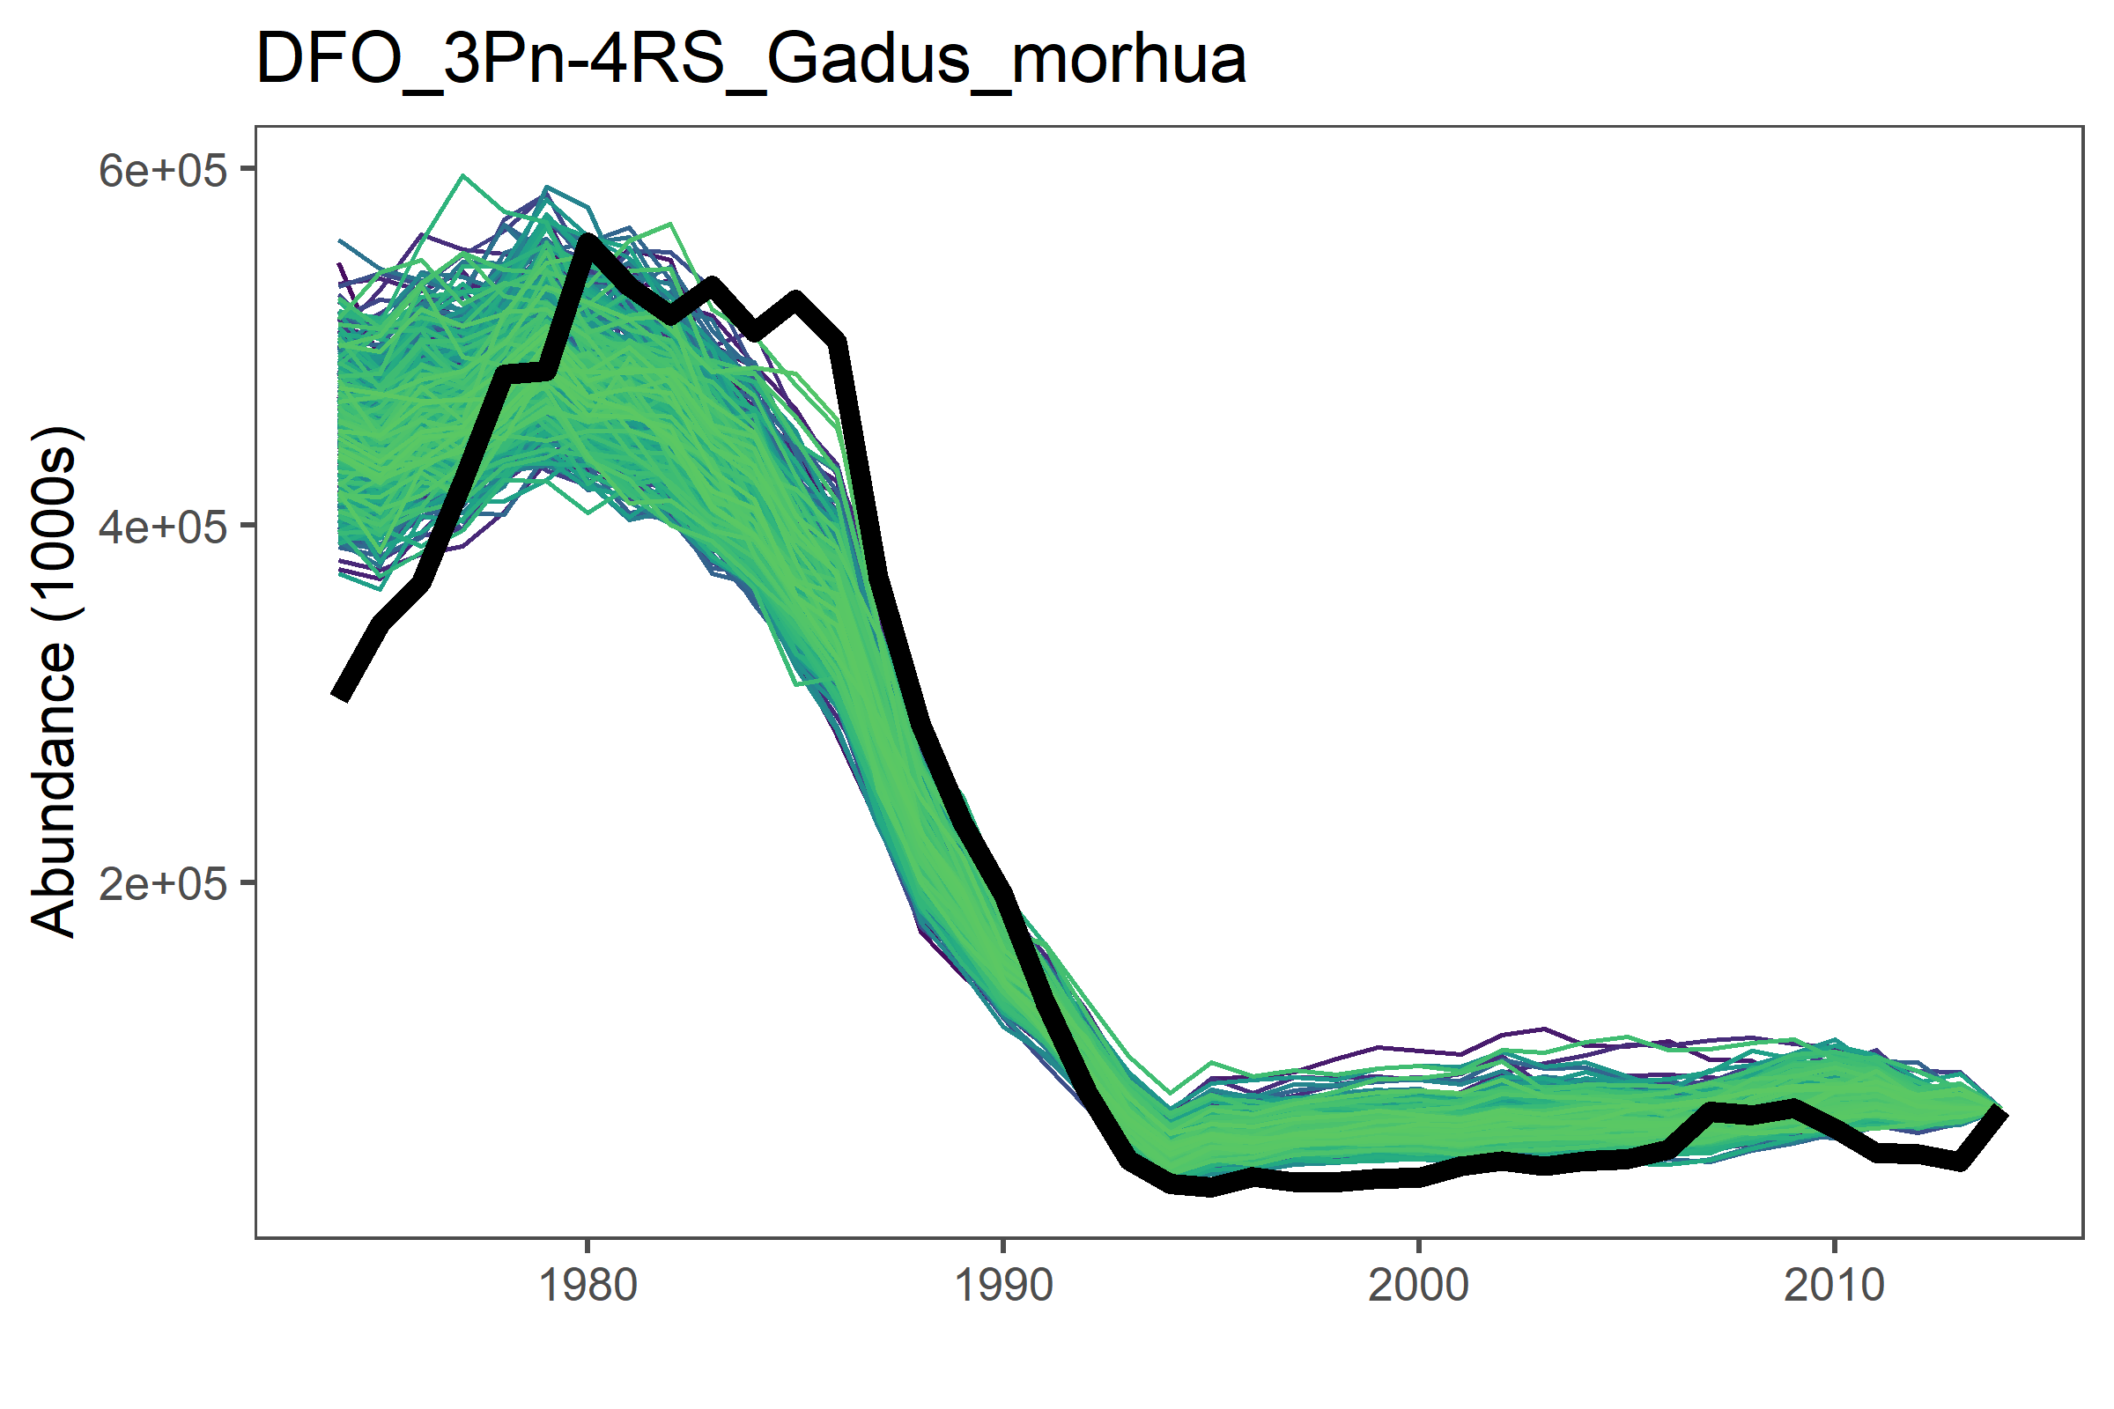
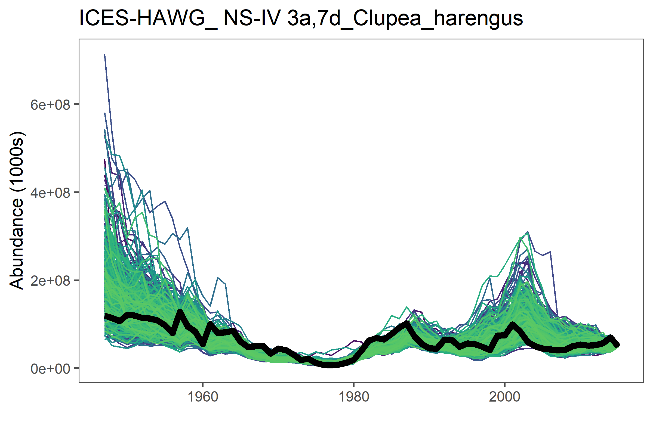
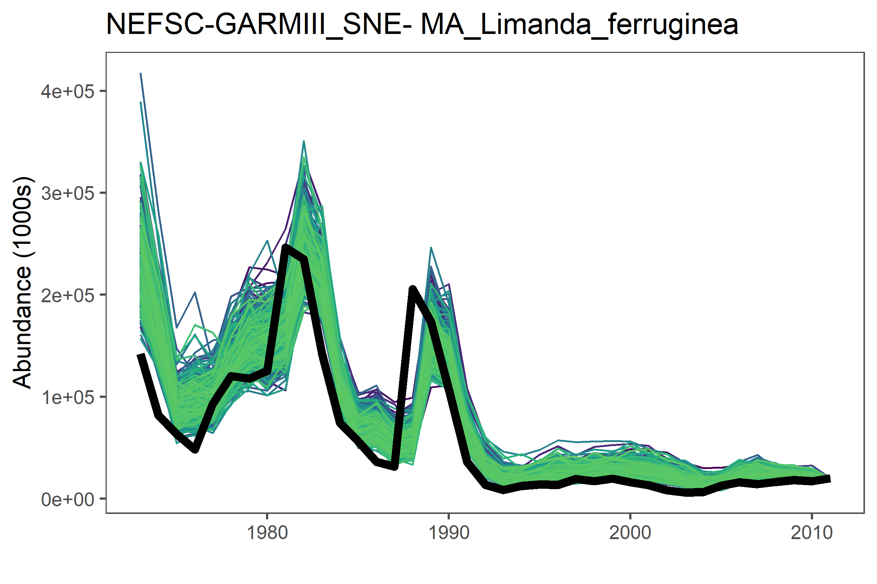
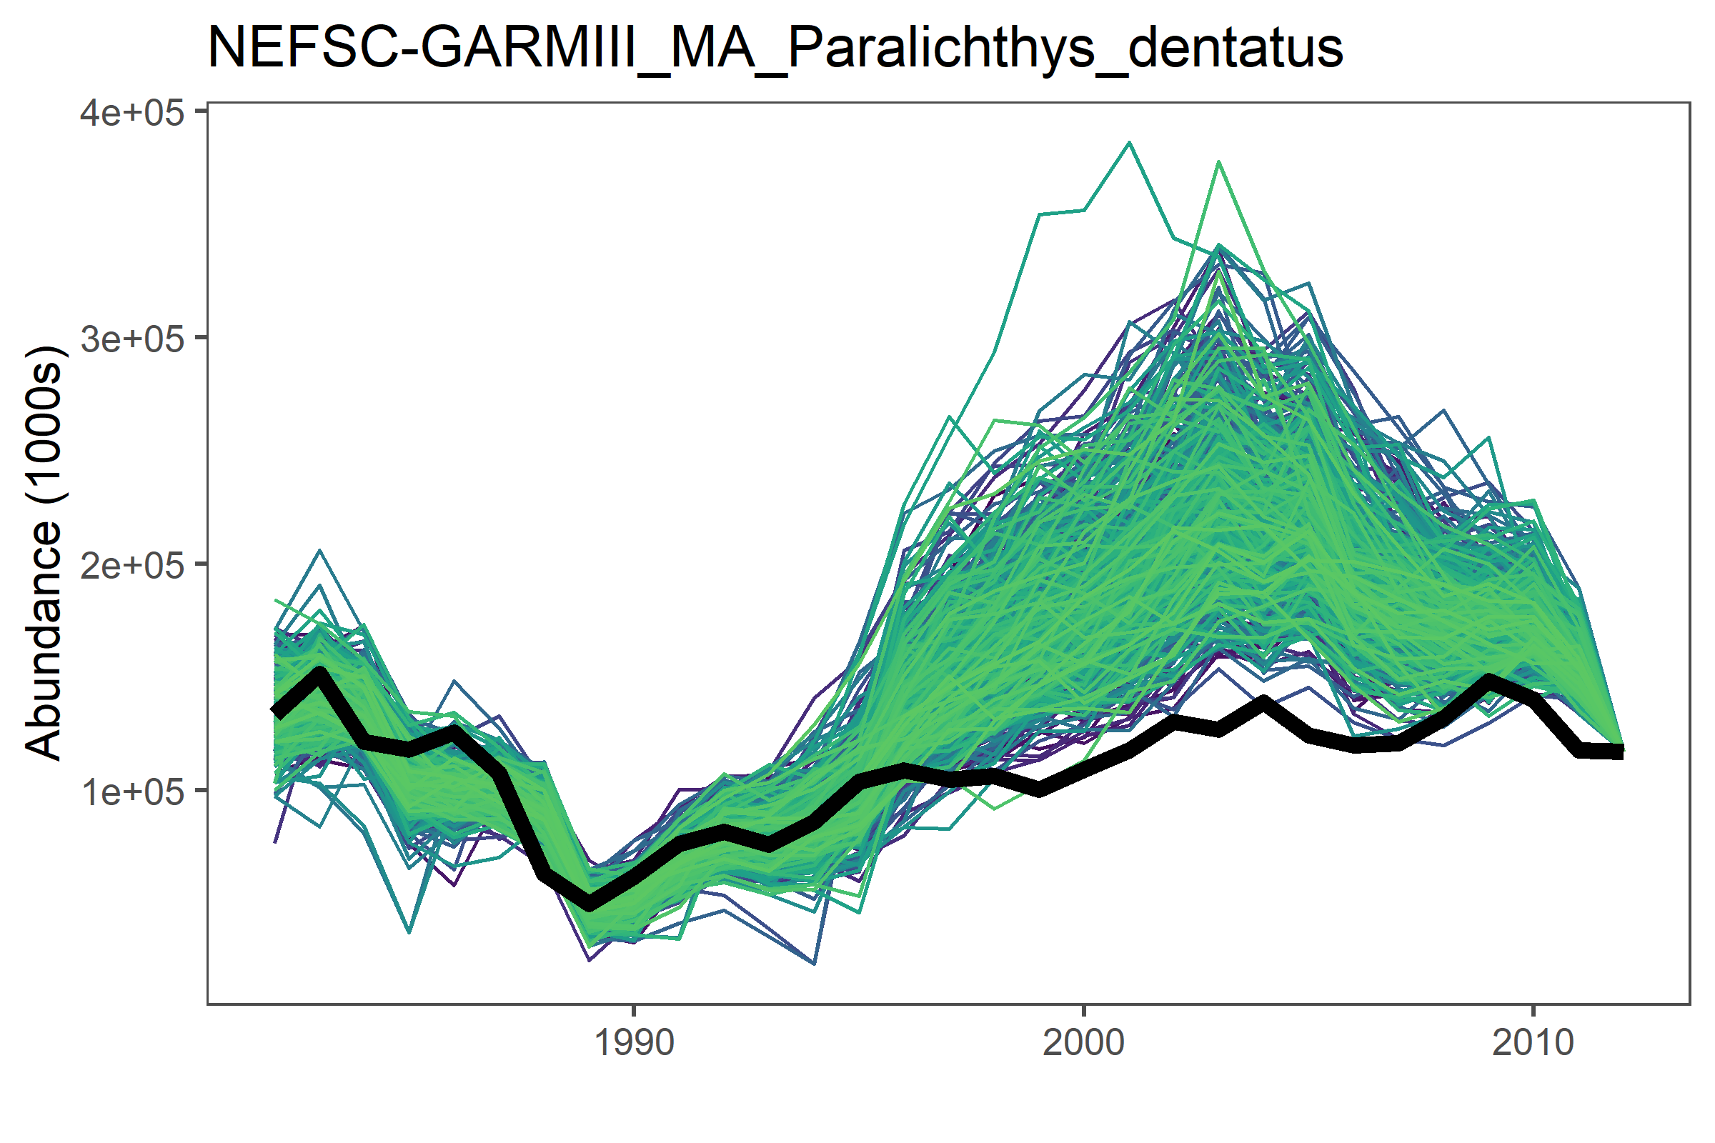
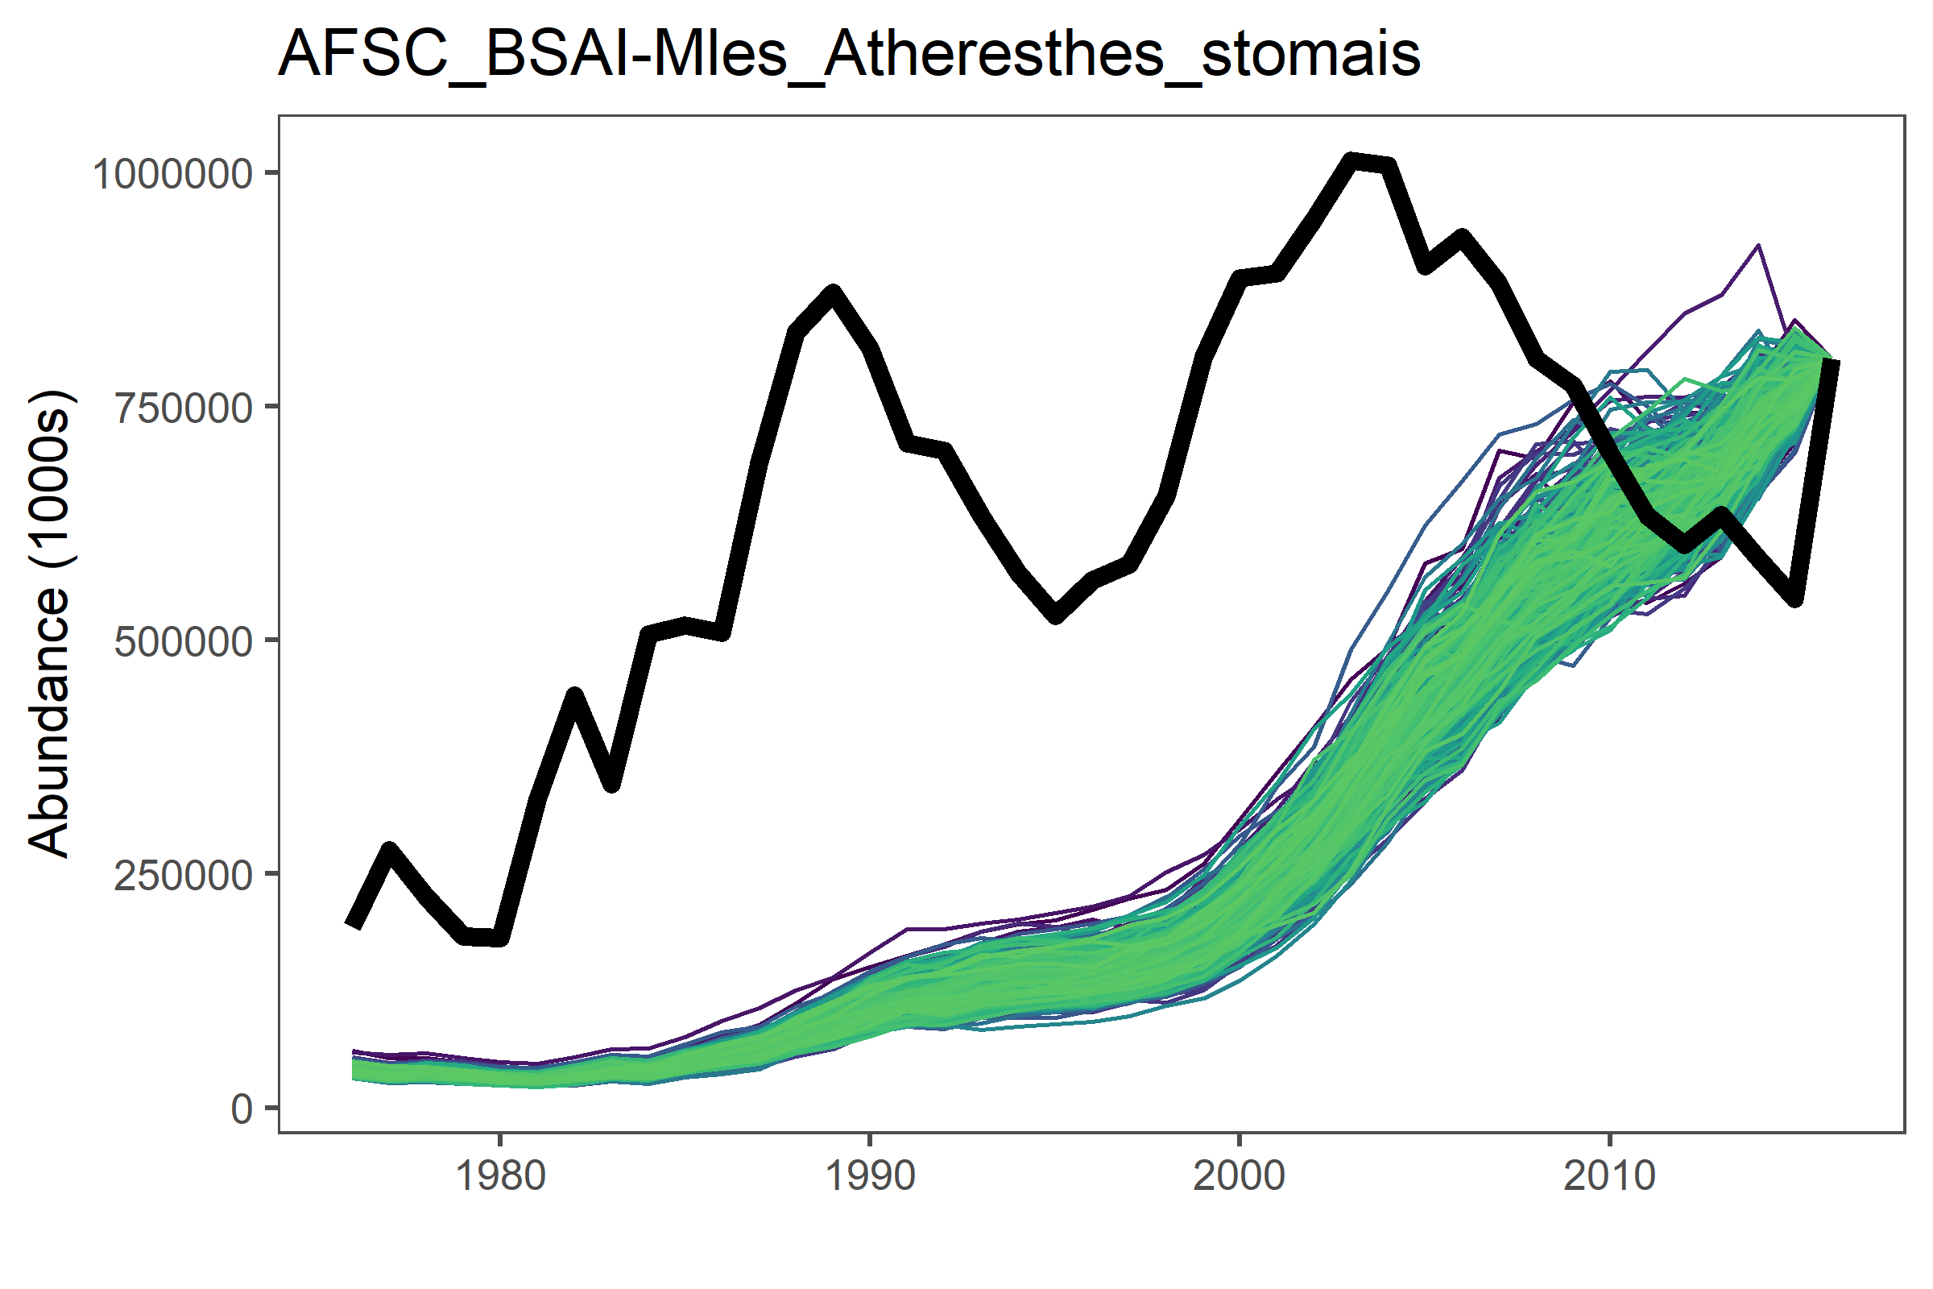
Testing ICM on Marine Fishes
We are ‘proving’ the model on a Marine Fisheries Database
Backwards prediction of population trends
We have 82 data rich stocks
Still a work in progress but….

Slide 10




Back to the future
Simulating the fishery
How to build in fishing scenarios
Business as usual should be our baseline
Will depend on how ‘big’ we make our ecosystem
Will need to be tractable to start
We can expand as we go

Slide 11
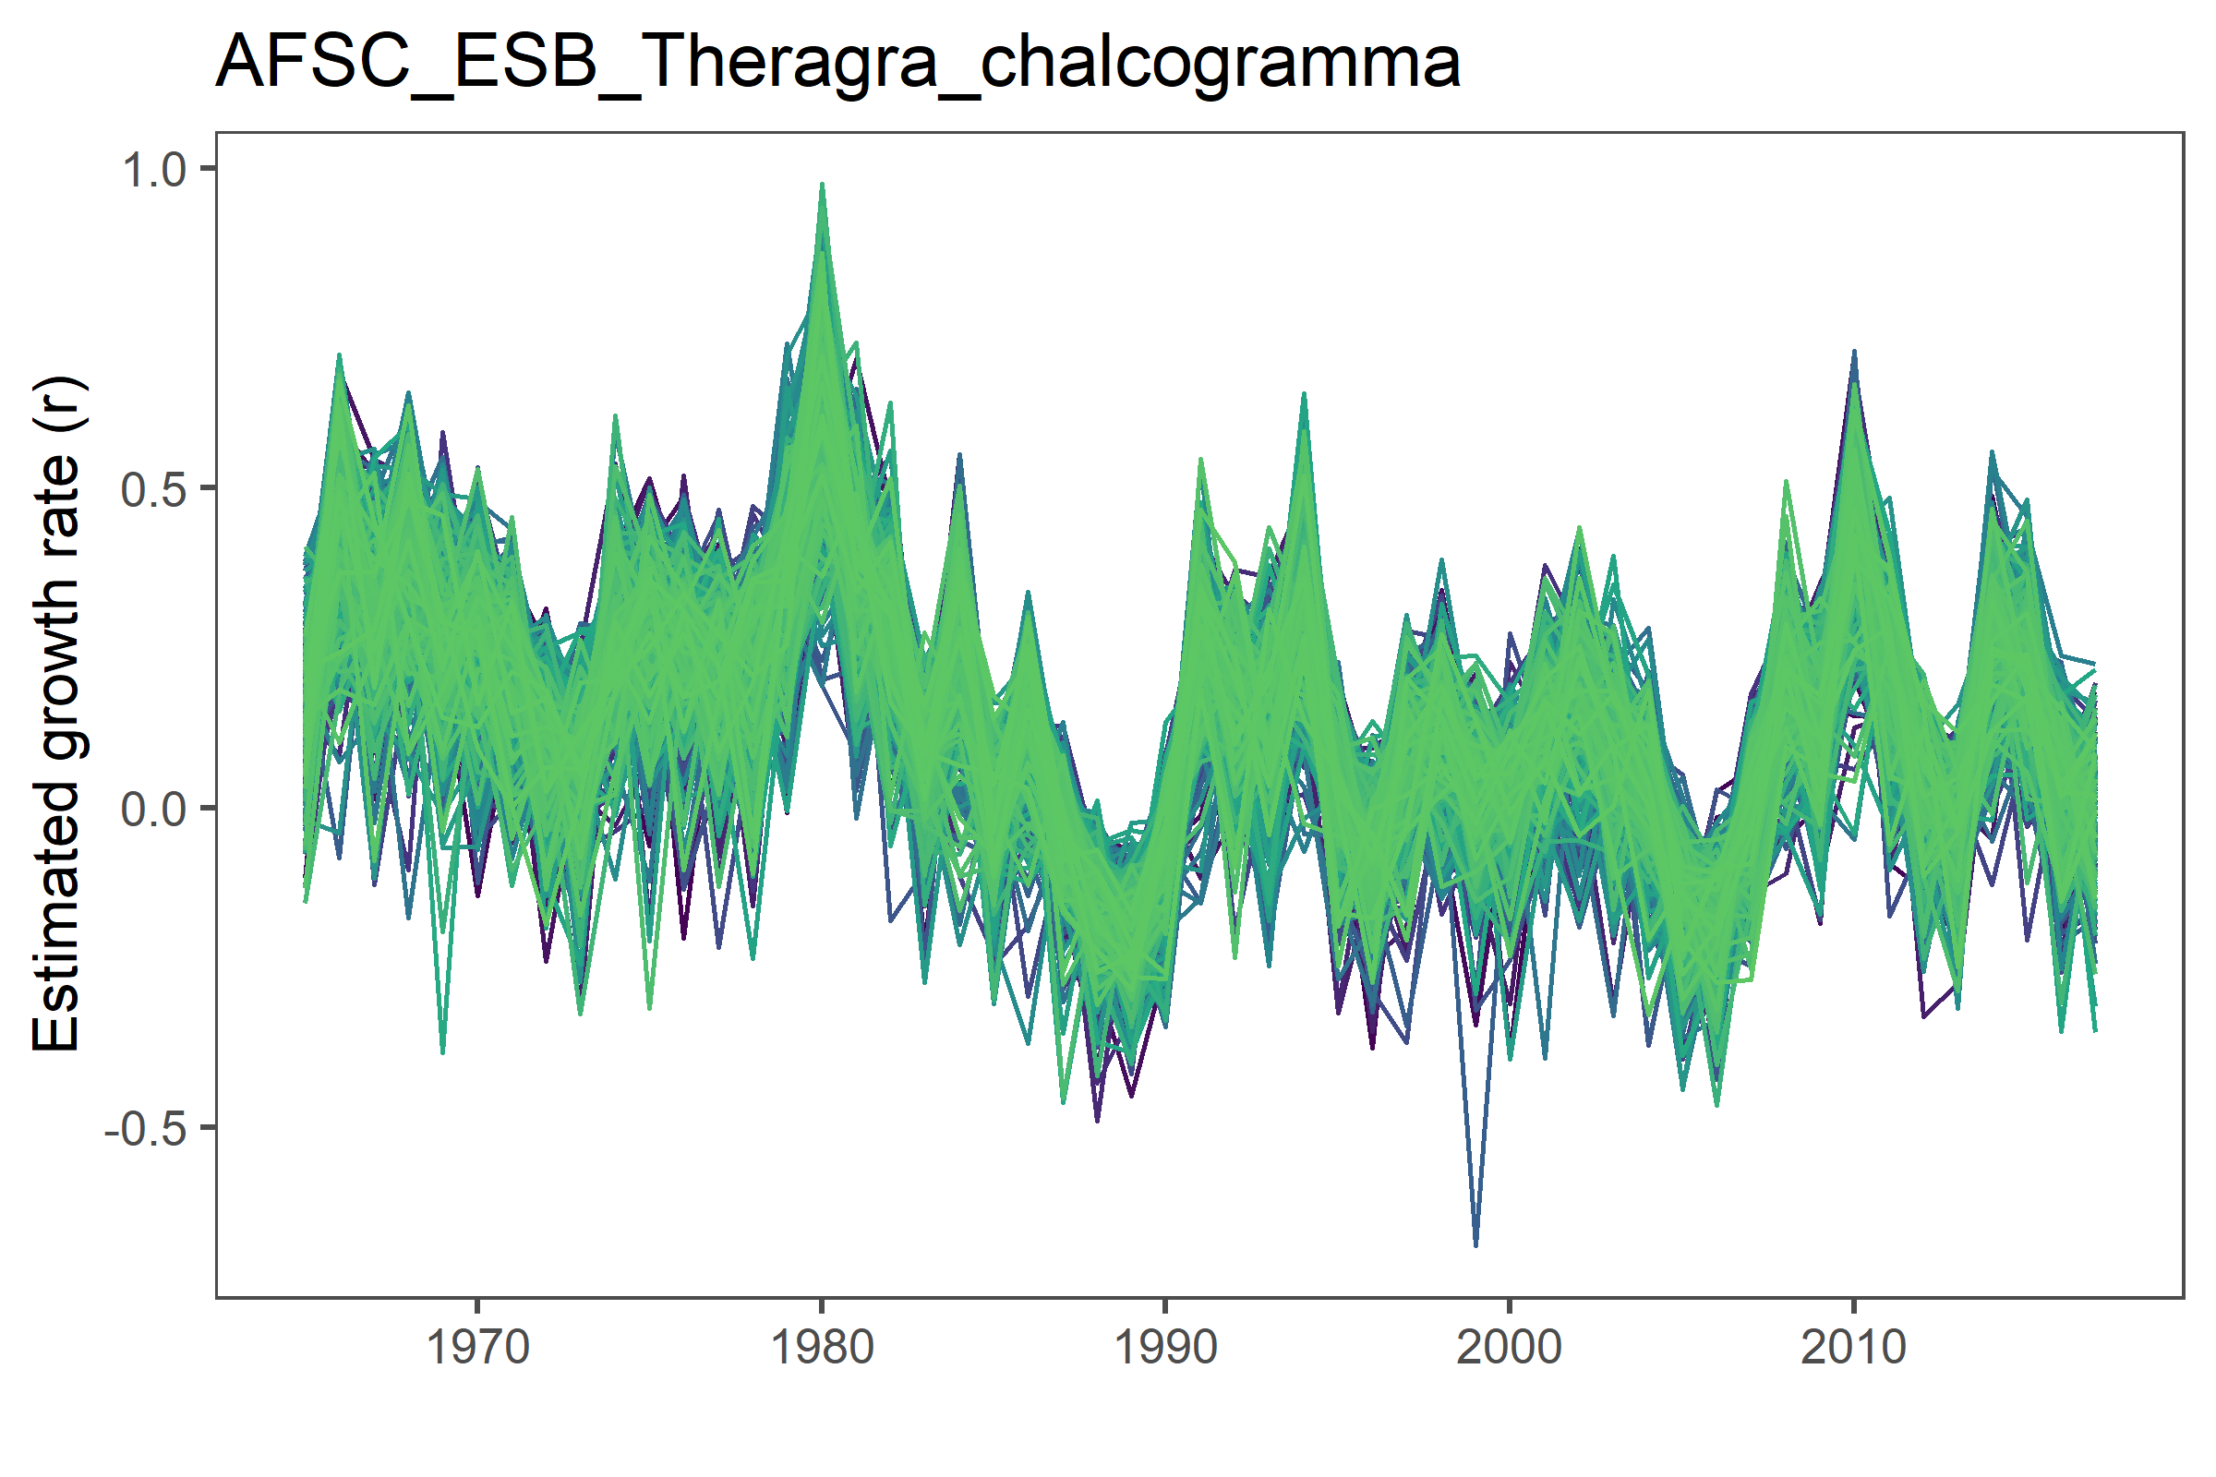
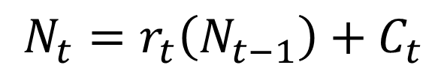
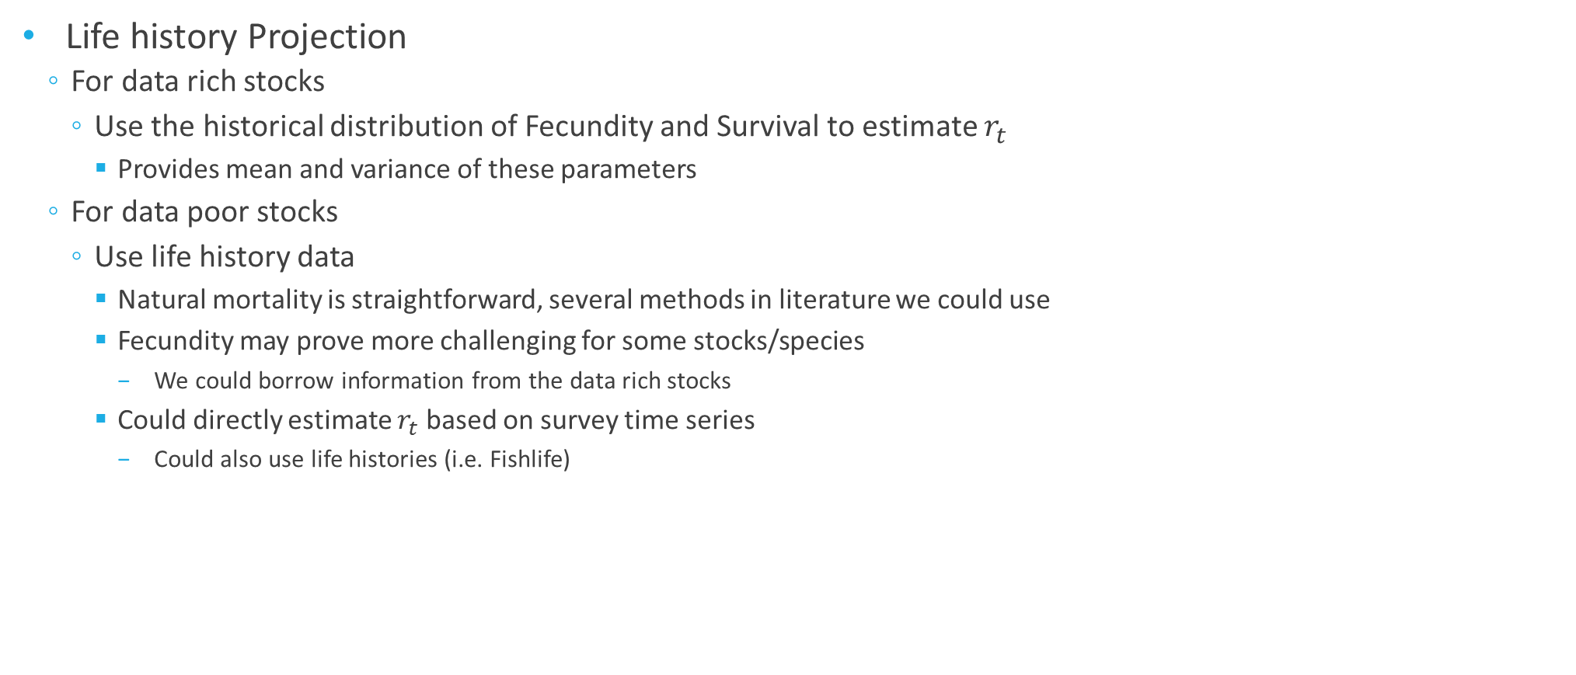
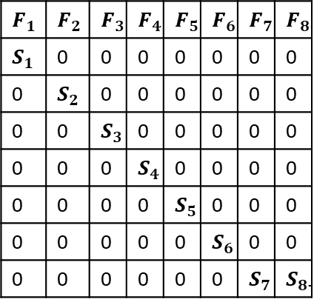
Back to the future
Life history Projection
For data rich stocks
Use the historical distribution of Fecundity and Survival to estimate $r_{t}$
Provides mean and variance of these parameters
For data poor stocks
Use life history data
Natural mortality is straightforward, several methods in literature we could use
Fecundity may prove more challenging for some stocks/species
We could borrow information from the data rich stocks
Could directly estimate $r_{t}$ based on survey time series
Could also use life histories (i.e. Fishlife)
$$F_{1}$$ | $$F_{2}$$ | $$F_{3}$$ | $$F_{4}$$ | $$F_{5}$$ | $$F_{6}$$ | $$F_{7}$$ | $$F_{8+}$$
$$S_{1}$$ | 0 | 0 | 0 | 0 | 0 | 0 | 0
0 | $$S_{2}$$ | 0 | 0 | 0 | 0 | 0 | 0
0 | 0 | $$S_{3}$$ | 0 | 0 | 0 | 0 | 0
0 | 0 | 0 | $$S_{4}$$ | 0 | 0 | 0 | 0
0 | 0 | 0 | 0 | $$S_{5}$$ | 0 | 0 | 0
0 | 0 | 0 | 0 | 0 | $$S_{6}$$ | 0 | 0
0 | 0 | 0 | 0 | 0 | 0 | $$S_{7}$$ | $$S_{8+}$$
$$N_{t}=r_{t}\left(N_{t−1}\right)+C_{t}$$

Slide 12
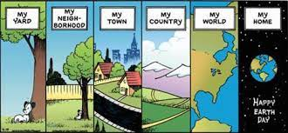
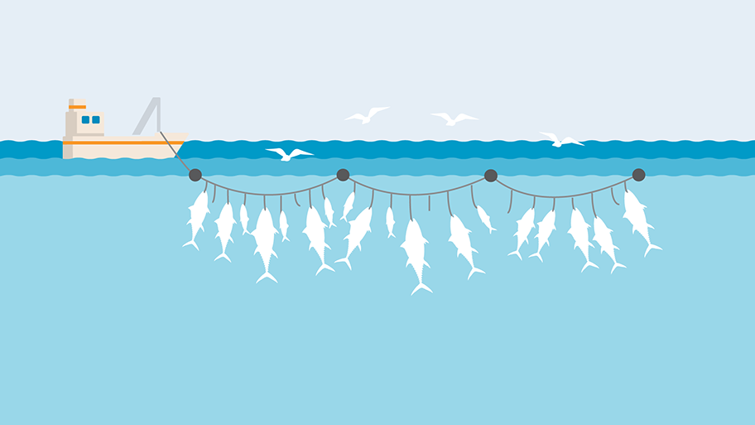
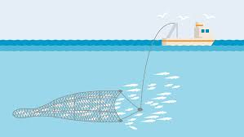

Back to the future
Our ‘ecosystem’ and functional diversity?
Need to define our ‘world’
How many species in our ecosystem
Biomass
Combining data rich (assessments) with data limited (surveys)
How do we deal with selectivity/catchability for the data limited species we include?
Hey Hal, look at the stupid fish!

Slide 13
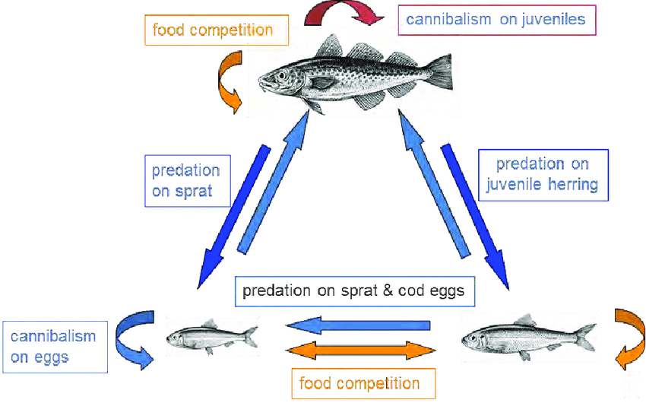
Back to the future
Interactions between species
Start simple with no interactions between species
Likely model will go to extremes though
Build to include interactions between fecundity, mortality, or r itself

Slide 14
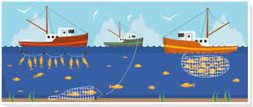
Back to the future
What about climate change?
Many options here
Productivity of the system
Biomass
Fecundity
Natural mortality
Rate of growth (r)
interactions

Slide 15
Topics of discussion
Modelling framework
Ecosystem Definition
Fishing Scenarios
Incorporating Climate

Slide 16
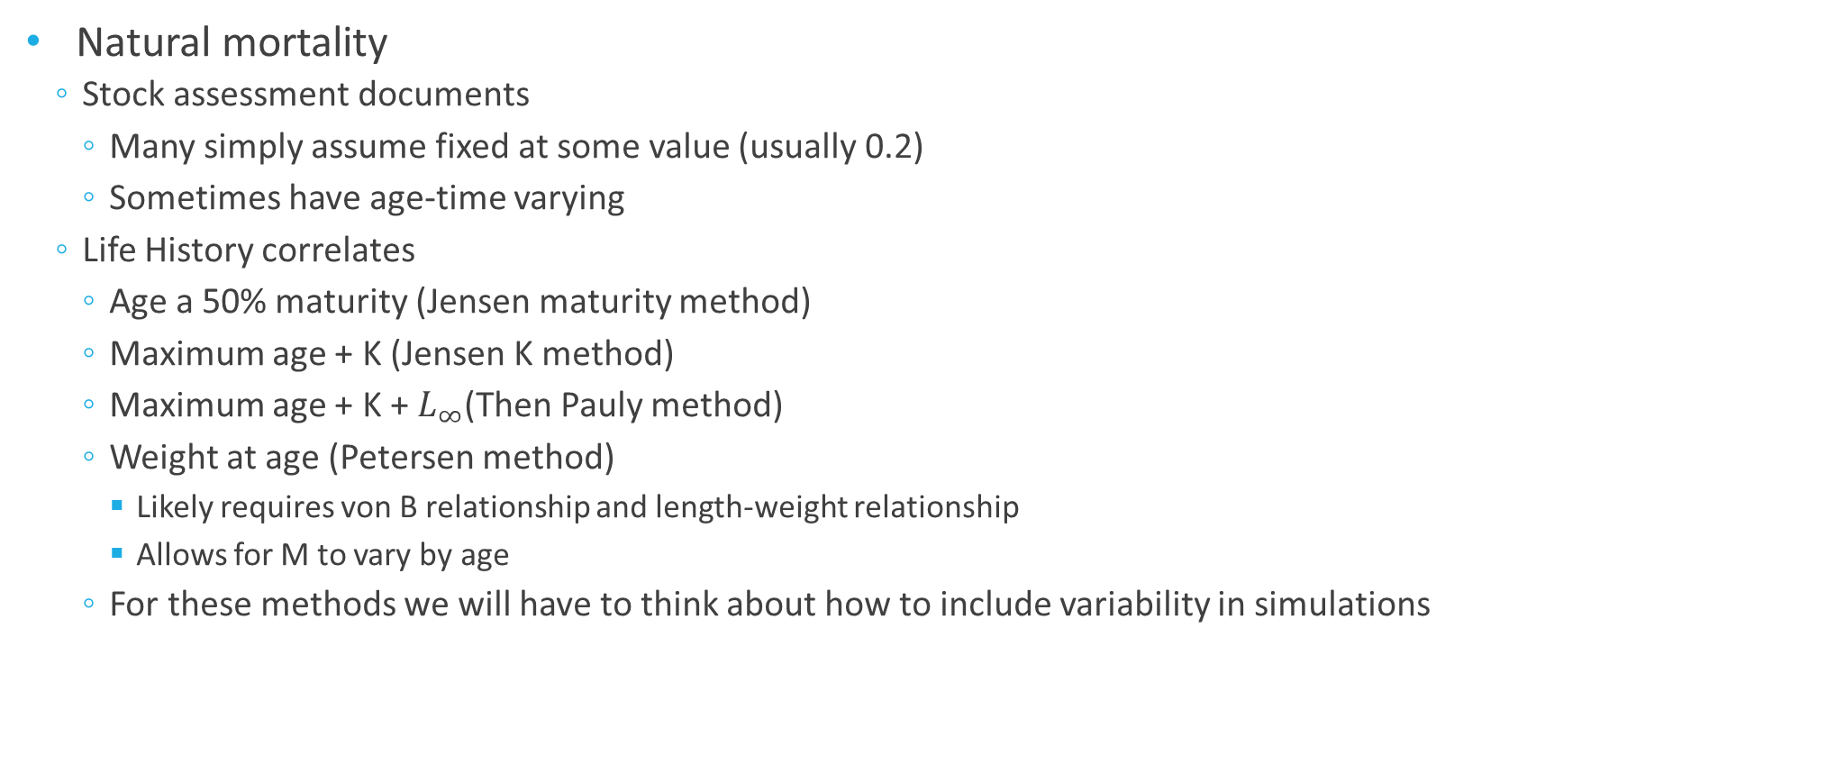
Life History Traits
Natural mortality
Stock assessment documents
Many simply assume fixed at some value (usually 0.2)
Sometimes have age-time varying
Life History correlates
Age a 50% maturity (Jensen maturity method)
Maximum age + K (Jensen K method)
Maximum age + K + $L_{∞}$(Then Pauly method)
Weight at age (Petersen method)
Likely requires von B relationship and length-weight relationship
Allows for M to vary by age
For these methods we will have to think about how to include variability in simulations

Slide 17
Life History Traits
Fecundity
This one is more of a challenge
Stock assessment documents
Recruitment time series + Weights at age + Numbers at age = fecundity
Provides nice ‘history’ of fecundity and fecundity variability in these stocks
Life History correlates
Fecundity length relationships exist for many species/stock
Using Egg production is a challenge
Requires knowledge of egg mortality…
99.9% will give very different result from 99.99999% egg mortality
Could borrow from other assessments
Needs more thought.

Slide 18
Life History Traits
Rate of growth (r)
When we have fecundity and natural mortality, we have r
What if we don’t?
Life history correlates certainly could be used
Age at maturity
Fecundity
Maximum body size
Growth rates

Slide 19
Simulating the ecosystem
Where do we start?
For ‘actual’ ecosystems, identifying the baseline community structure
May be challenging for poorly sampled species
Straightforward for assessed portion of the ecosystem
Ecosim/Ecopath model results could be used as ‘initial condition’
Theoretical ecosystem simulations
Do we need to develop a simulated ecosystem?
Enables us to understand how interactions effect species
Likely would help conceptualize how we deal with interactions

Slide 20
The Ecosystem
How big is our ecosystem
How many species
How should the different components of the ecosystem interact?
Start simple and build
Interactions could be set up to impact
Fecundity
e.g. when Cod are abundant recruitment of Herring could be low due to egg predation
Mortality
e.g. large Haddock year class may result in increased mortality of Cod due to competition
Intrinsic rate of growth (r)
e.g. Herring intrinsic rate of growth may be higher when few Cod and haddock in ecosystem
Many options here!

Slide 21
Climate change

Slide 22
Discuss how we aren’t really dealing with spatial anything…

